Slide 1
Software for Synthetic Biology Workflows
Jake Beal, Raytheon BBN Technologies
Ernst Oberortner, JBEI
Kevin Clancy, Synthetic Genomics

Slide 2
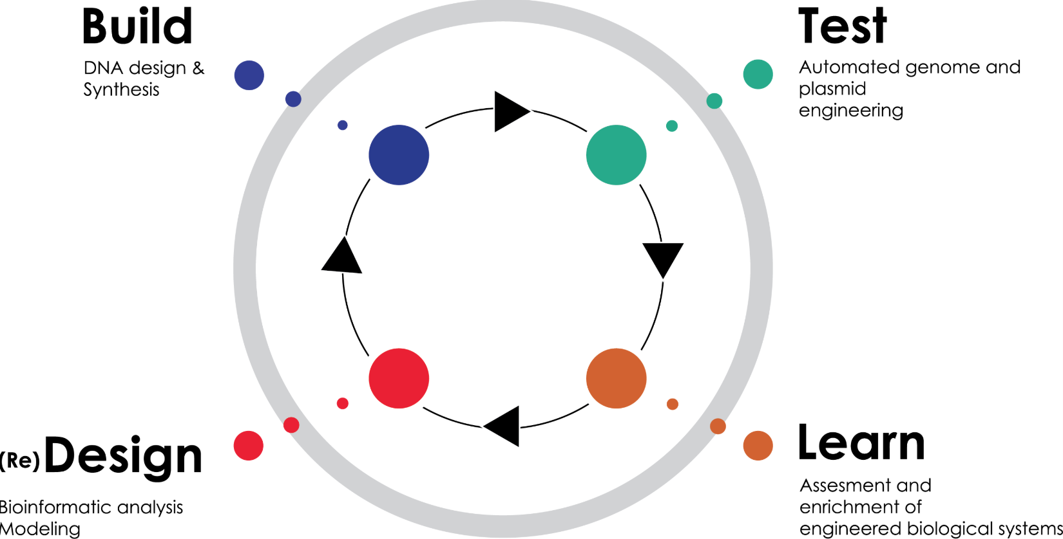
Purpose of the Workshop
SBOL has been adopted by many developers
www.sbolstandard.org
28 separate applications
Now the question becomes:
What do I need to use?
How do I use it?
This workshop will:
Show you how to get and convert sequences to and from SBOL
Show you how to construct your designs
Show you how to get your designs built
Show you how to save & share your designs

Slide 3
How We have Organized This Workshop
You can follow the instructions as I perform them
You can download the data and tutorials from GitHub
www.github.com/MadraghRua/SEED-Workshop-2018.git
You can copy the data, tutorials from USB drives I have with me
Tutorials are organized by Software we will be using
Jake, Ernst and our volunteers will be available on the floor as we go through the demonstrations
Don’t hesitate to ask questions as we move along
Overall goals
You should be able to use the tools we demo today
You can continue your training by following the other training modules we have included with the content

Slide 4
Example 1 – SynBioHub.org
https://synbiohub.org/
SynBioHub is a registry for storing and sharing genetic circuit designs using the SBOL2 standard. Designs can be uploaded in SBOL or GenBank format, assigned a public link to share with collaborators and for publications, and searched using rich querying functionality. Demo Contact Person: Anil Wipat Organization(s): Newcastle University Programming Language: JavaScript OS/Platform: Linux/Mac/Win/Web Availability: Open-Source License: BSD 2-Clause
There are 4 main types of repositories available for you to save and share data:
https://synbiohub.org
https://synbiohub.programmingbiology.org
https://synbiohub.utah.edu
https://synbiohub.cidalab.org

Slide 5
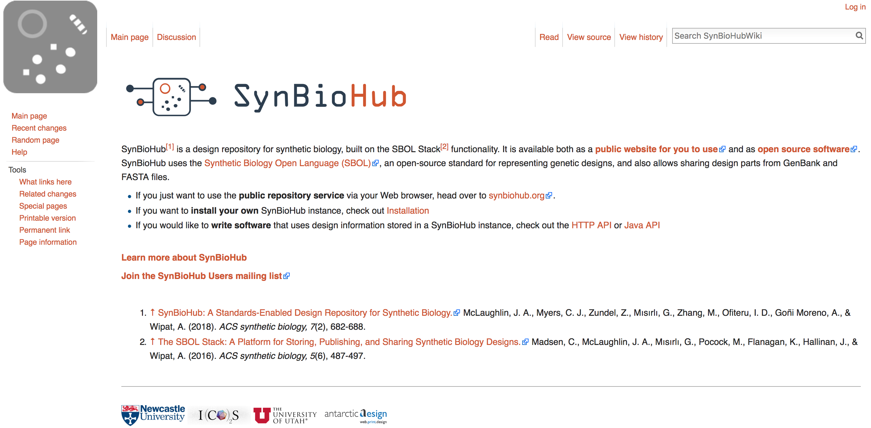

Slide 6
Log in Information for the Tutorial
Email: sbol.seed.2018@gmail.com
Password: seed2018

Slide 7
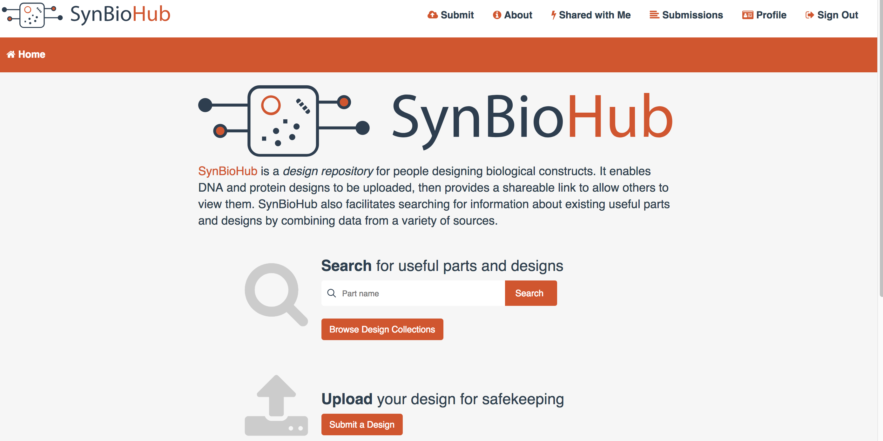
First we will browse the available Public Collections
ACTION
Log into SynBioHub
Select Browse Design Collections

Slide 8
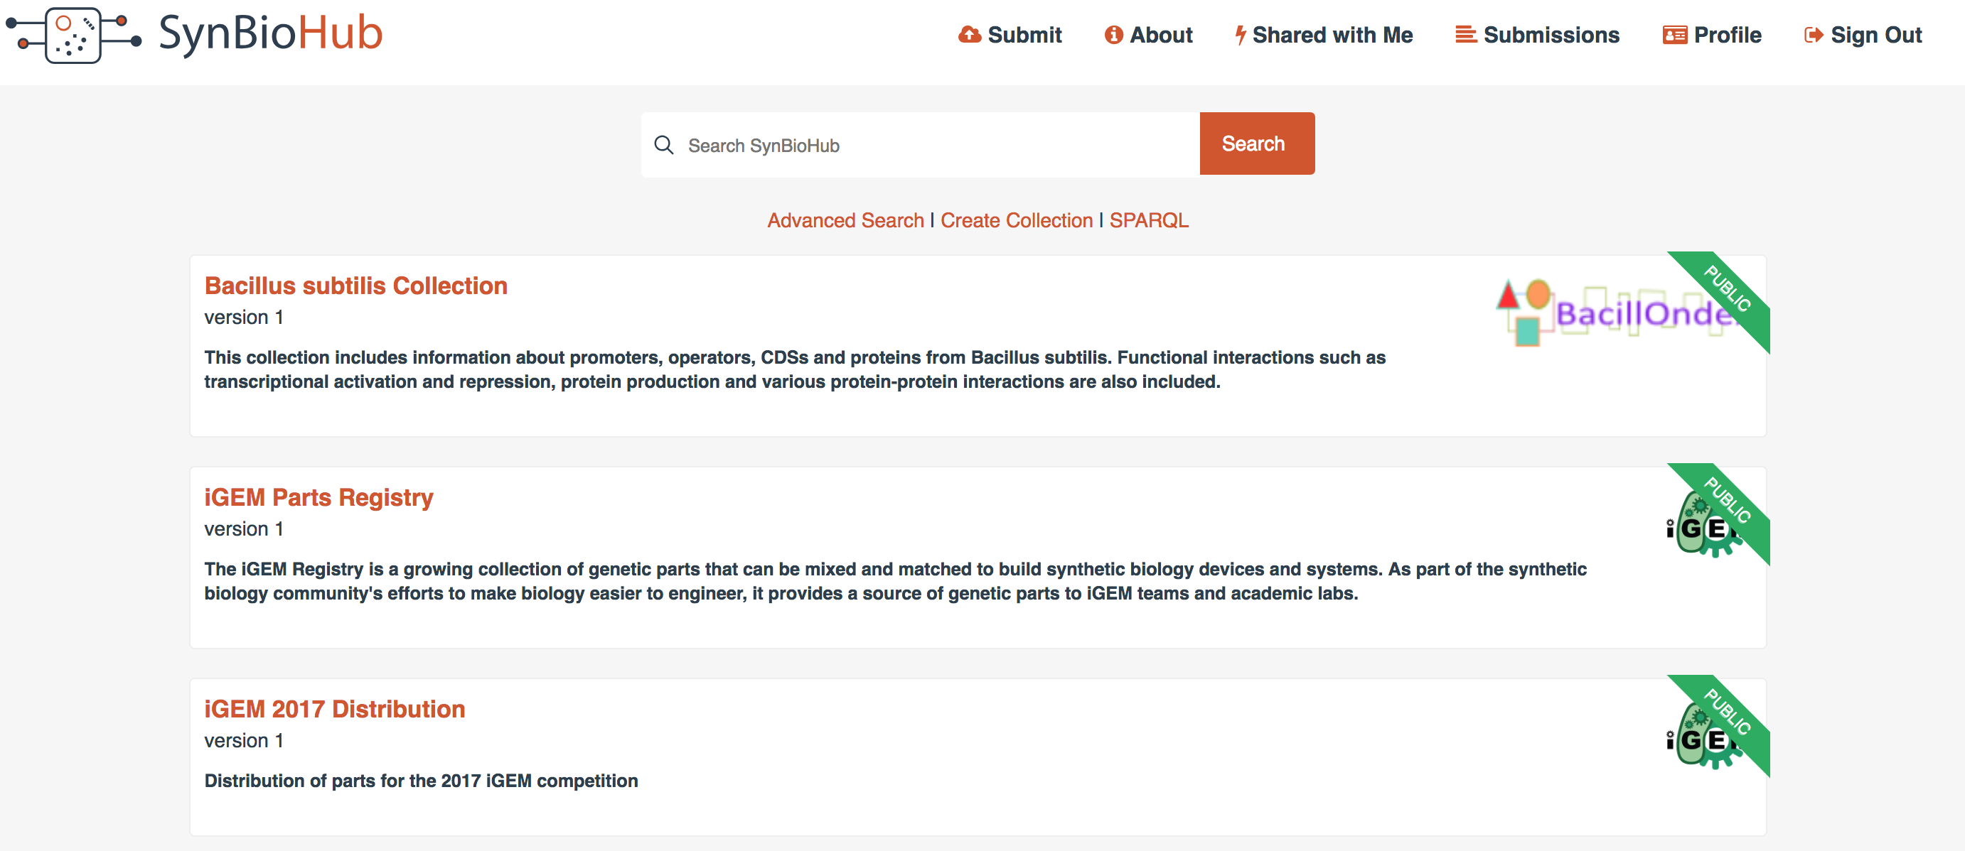
Many labs have loaded their data into SynBioHub
This data has been loaded as Collections
You can also use SynBioHub as a way to Publish data for publications, such as in ACS Synthetic Biology

Slide 9
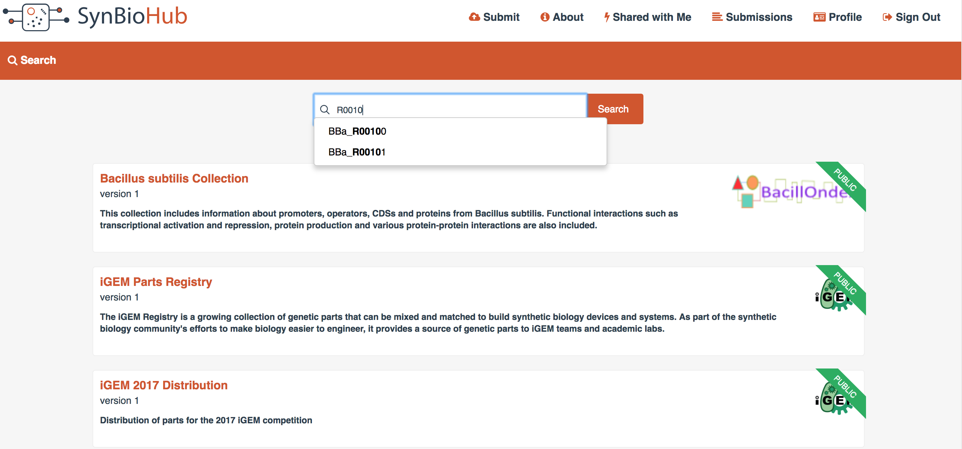
Searching for Parts
ACTION:
In the search box type in R0010
As you type in your part name you will see that the software will try to help you find the part as you type

Slide 10
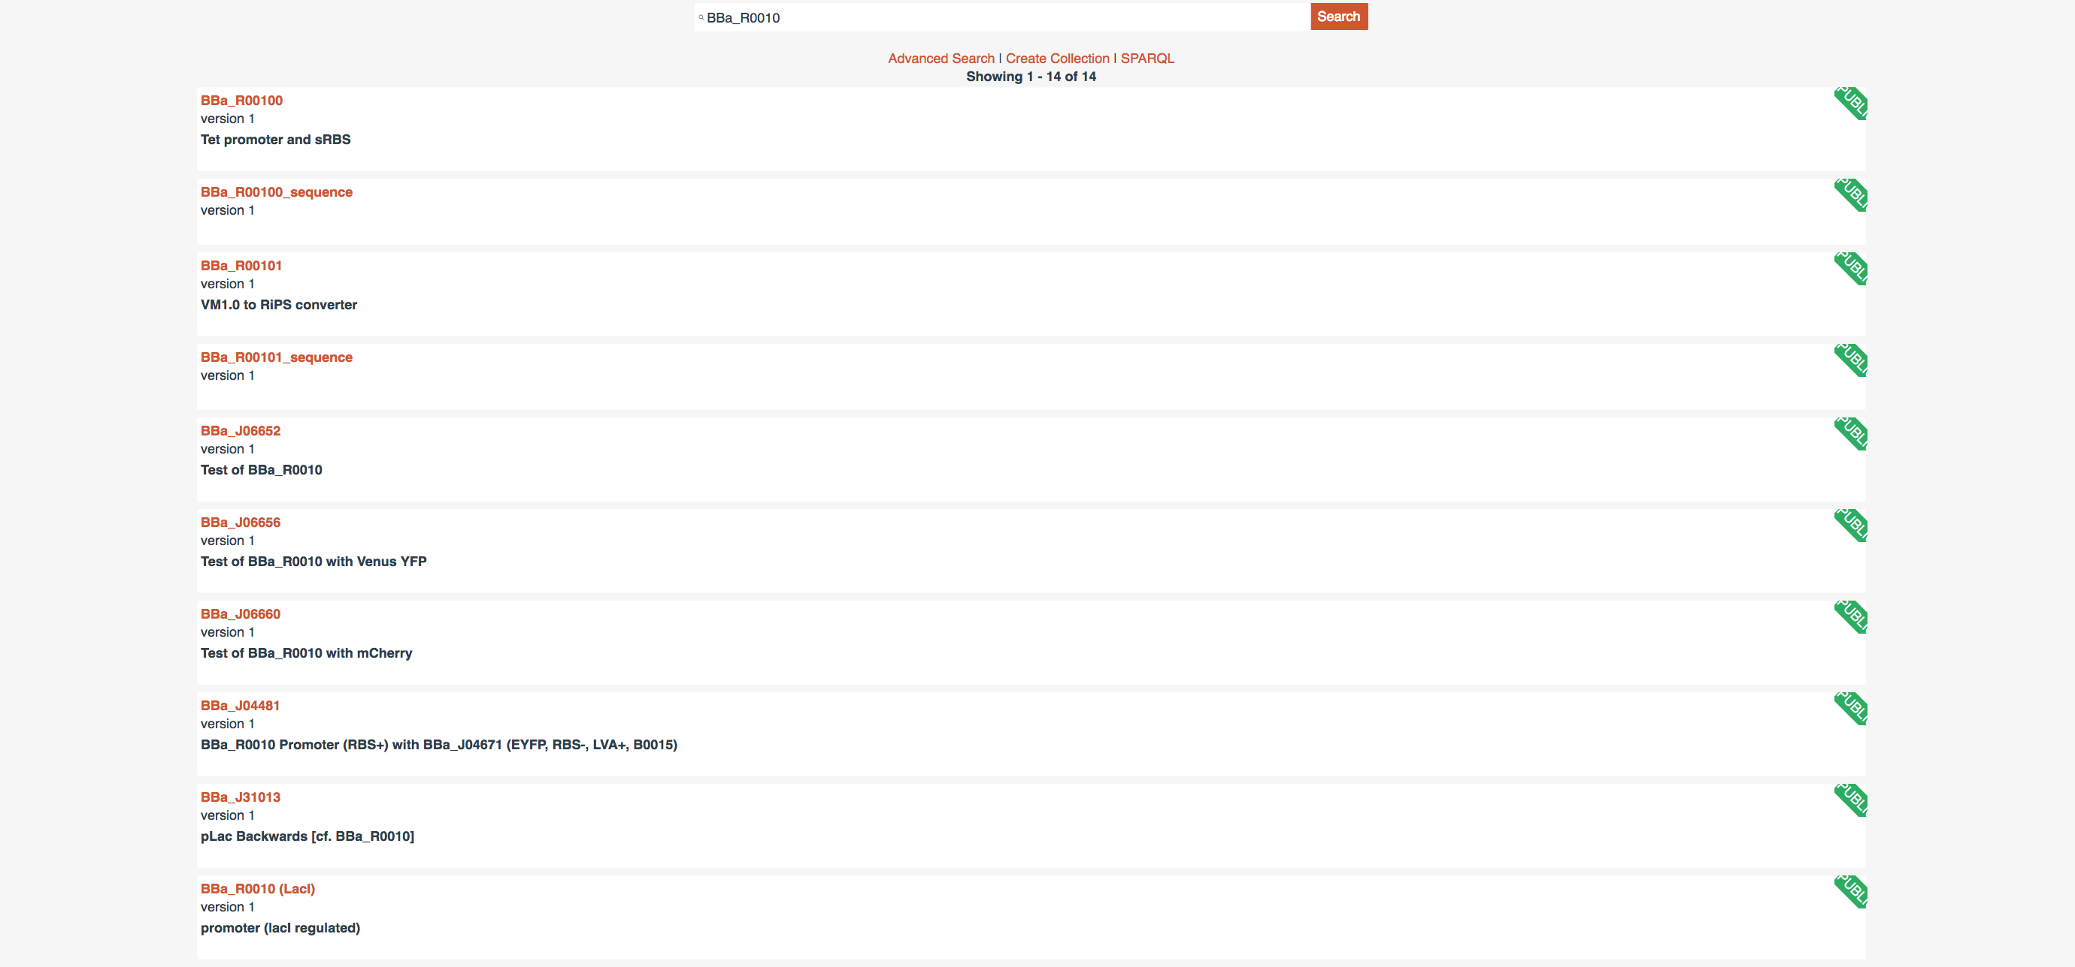
Open up BBa_R0010
SynBioHub will show you parts that
contain BBa_R0010 as well as the part
itself.
You will see the part listed both as a
Promoter as well as a sequence. We
want the promoter entry

Slide 11
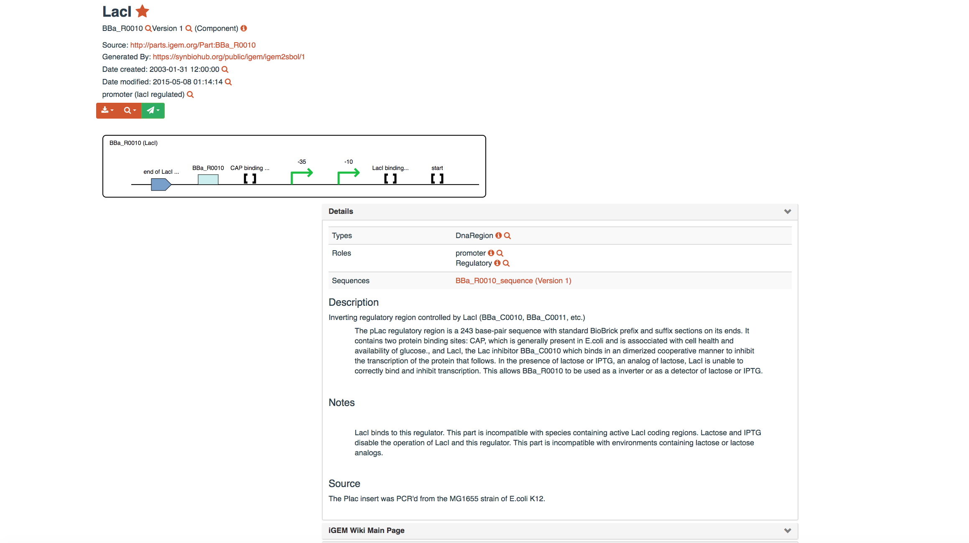
BBa_R0010 Details
The Details record has a number of elements:
There is a set of actions to be performed on the record
Select Download->SBOL File
The data for BBa_R0010 will be downloaded to your browser’s Download directory.
Create a Folder on your Desktop – “Example 1” and copy the file there.

Slide 12
Advanced Search – Available When You See a Search Dialog box
ACTION
Select the Creator drop down and type in Densmore
How many Parts has Doug submitted?

Slide 13
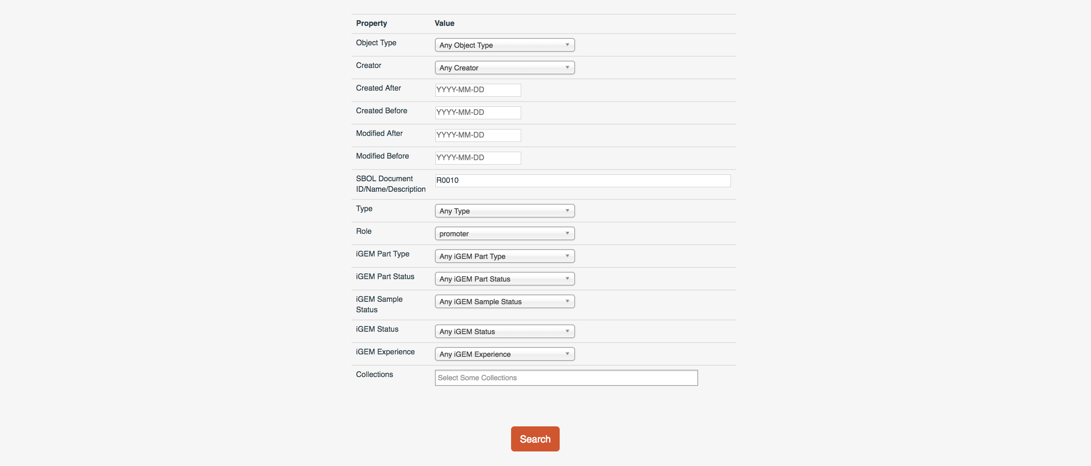
Advanced Search Example 2 – Search by Name and Role
ACTION
Type R0010 into the SBOL Document dialog box
Select Role->promoter
OUTCOME
See a new list of hits for R0010 that have Promoter roles

Slide 14
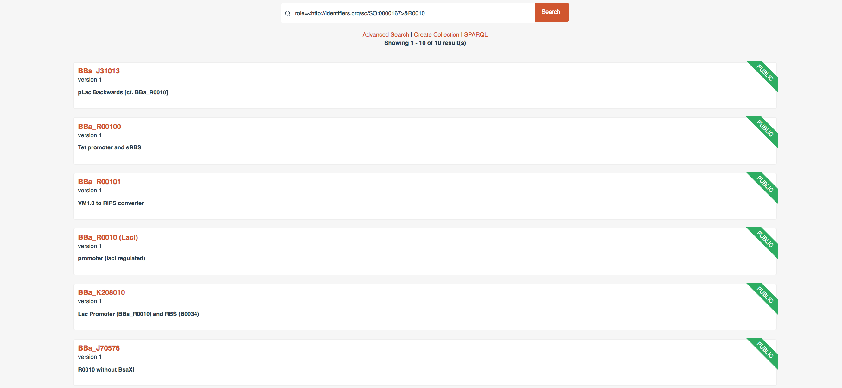
R0010 + Promoter role Result

Slide 15
Treasure Hunt
Using the basic Search box please find the following:
BBa_B0025
BBa_B0030
BBa_K145001
U6 promoter
dCAS9-GFP
Please download and store these in your Example 1 Folder

Slide 16
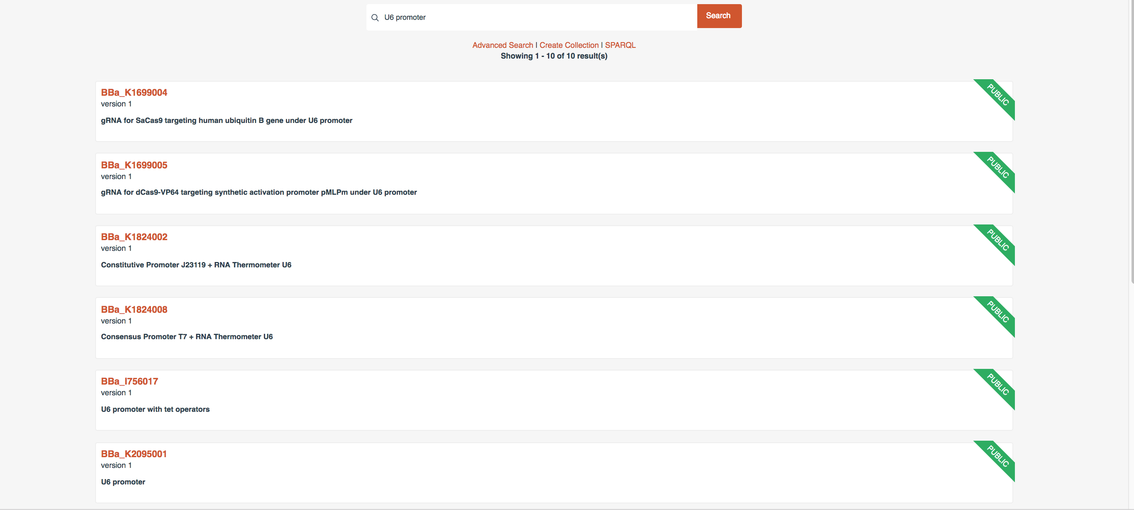
U6 Promoter Search

Slide 17
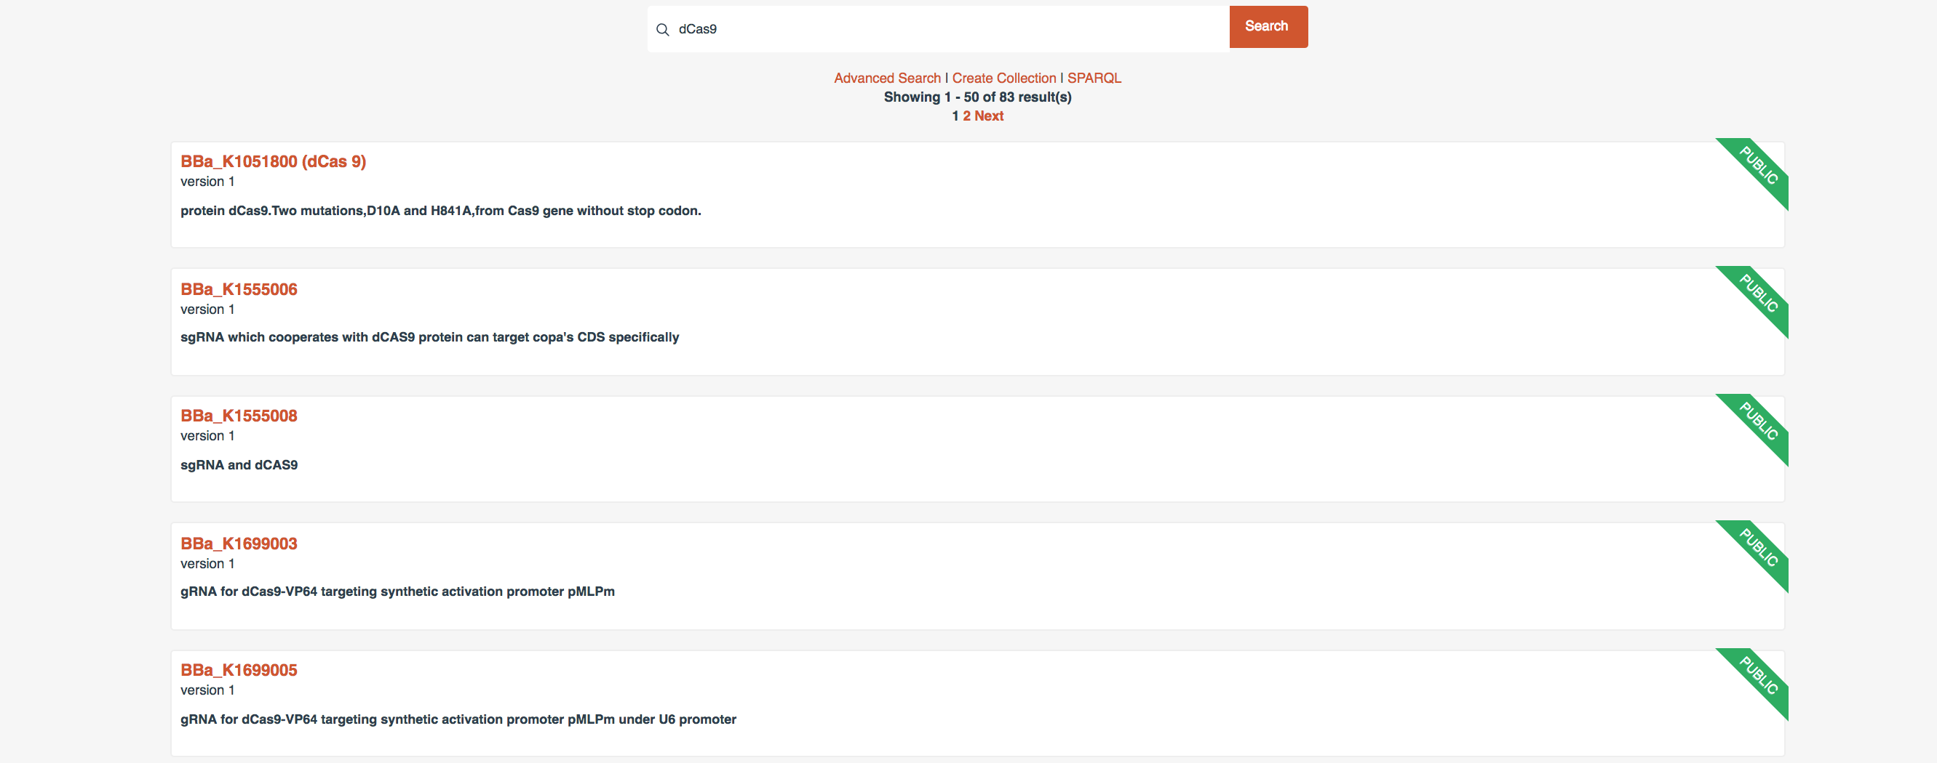
dCas9 Search results

Slide 18
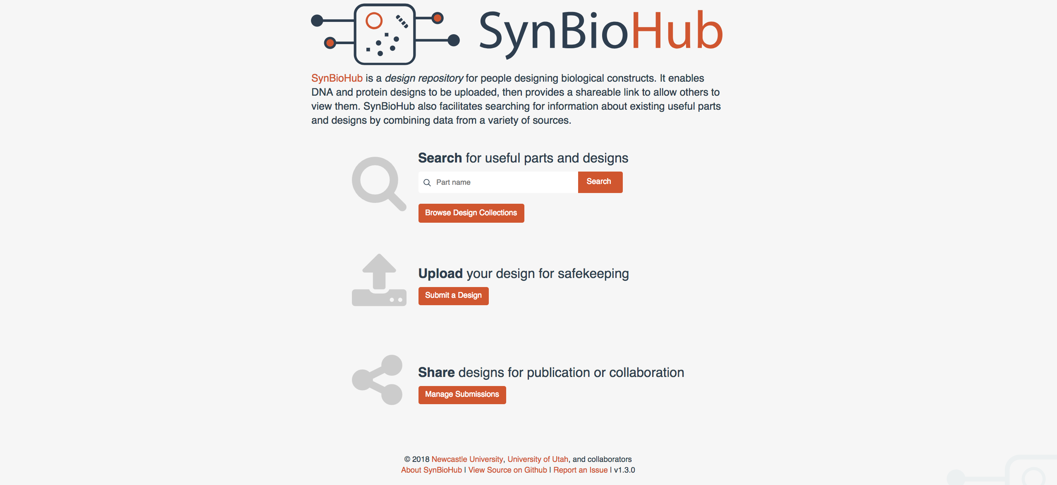
Create a Place to Store my Designs
ACTION
Return to the Main page by selecting the SynbioHub logo in the top left corner of the Page
Select the Submit a Design button

Slide 19
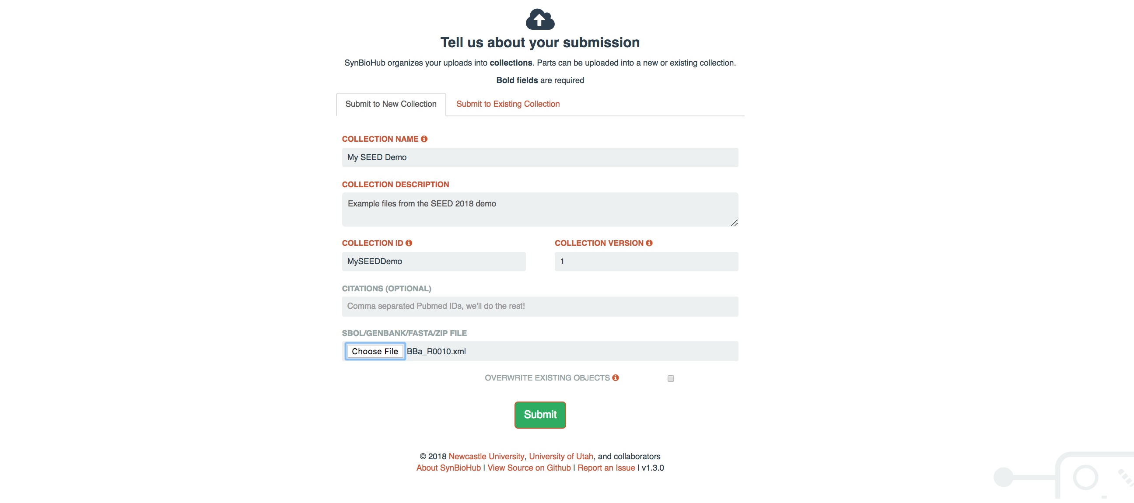
Setting up your collection
ACTION
Give it a name – base it on your name, organization, pet project, …
Give it a short description
Give it an AlpahNumeric Collection ID
Select one of your downloaded files
Hit Submit

Slide 20
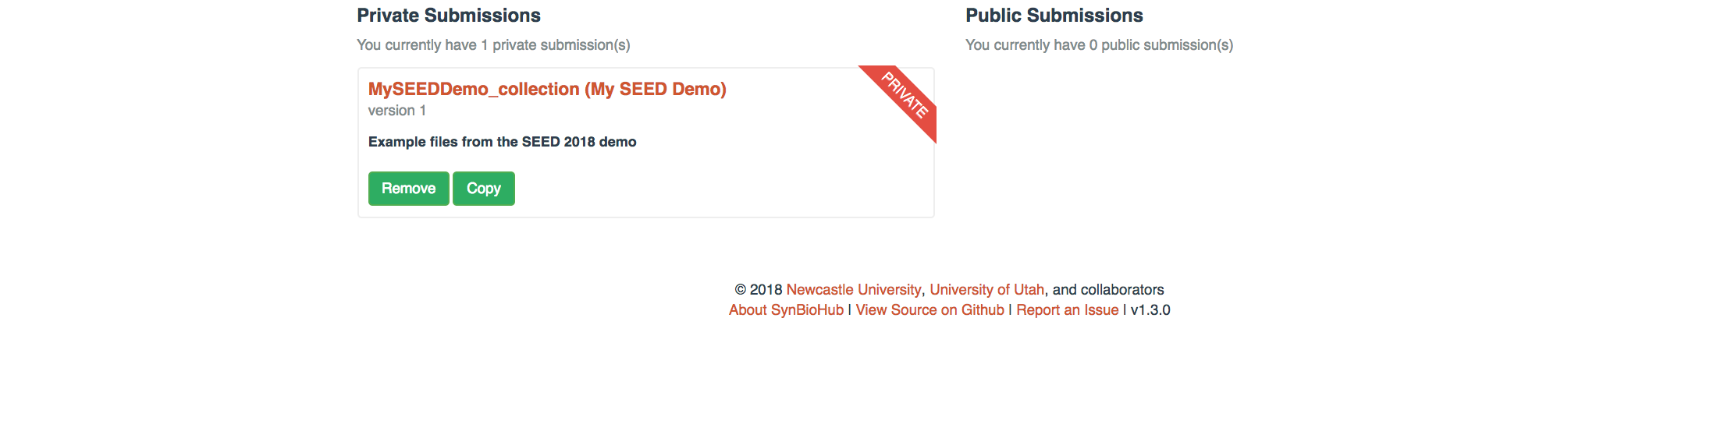
Result
Success – You now have a Private Submission
Want to make it Public?
Return the the main page and select the Manage Submission button

Slide 21
Example 1 Summary
Set up/use a SynBioHub account
Browse the collections
Basic Search
Advanced Search
Created a Private Collection

Slide 22
Example 2 – SBOL Designer
We will:
Install SBOLDesigner
Start a Design Project
Connect with SynBioHub to download parts
Use our files from the previous example to populate our design
Save it
Upload it to SynBioHub

Slide 23
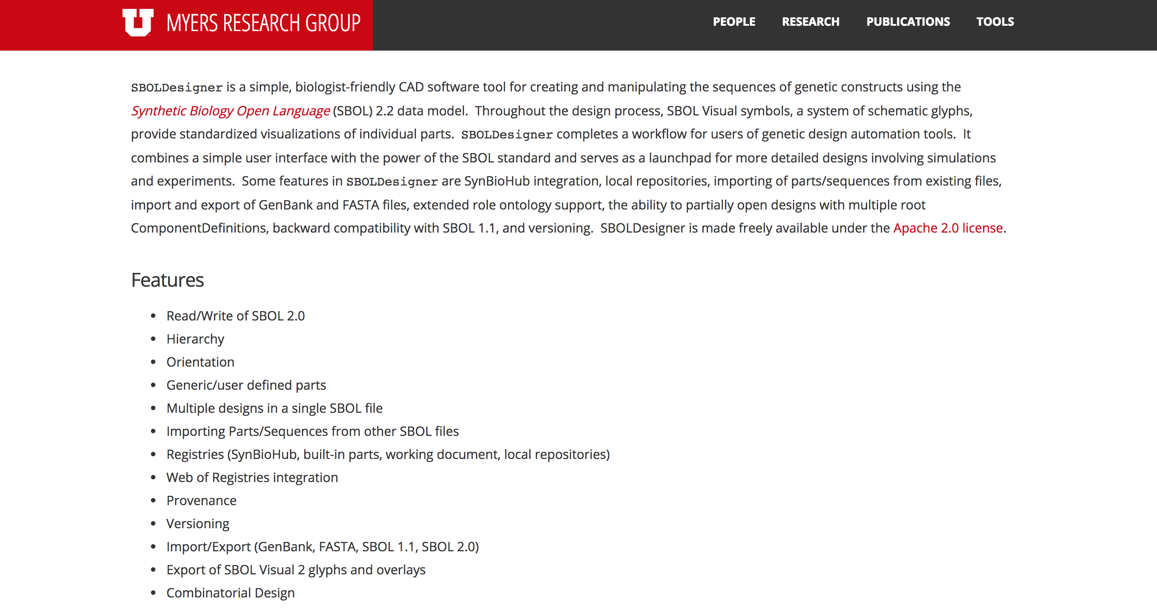
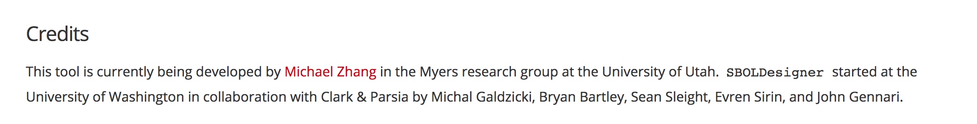

Slide 24
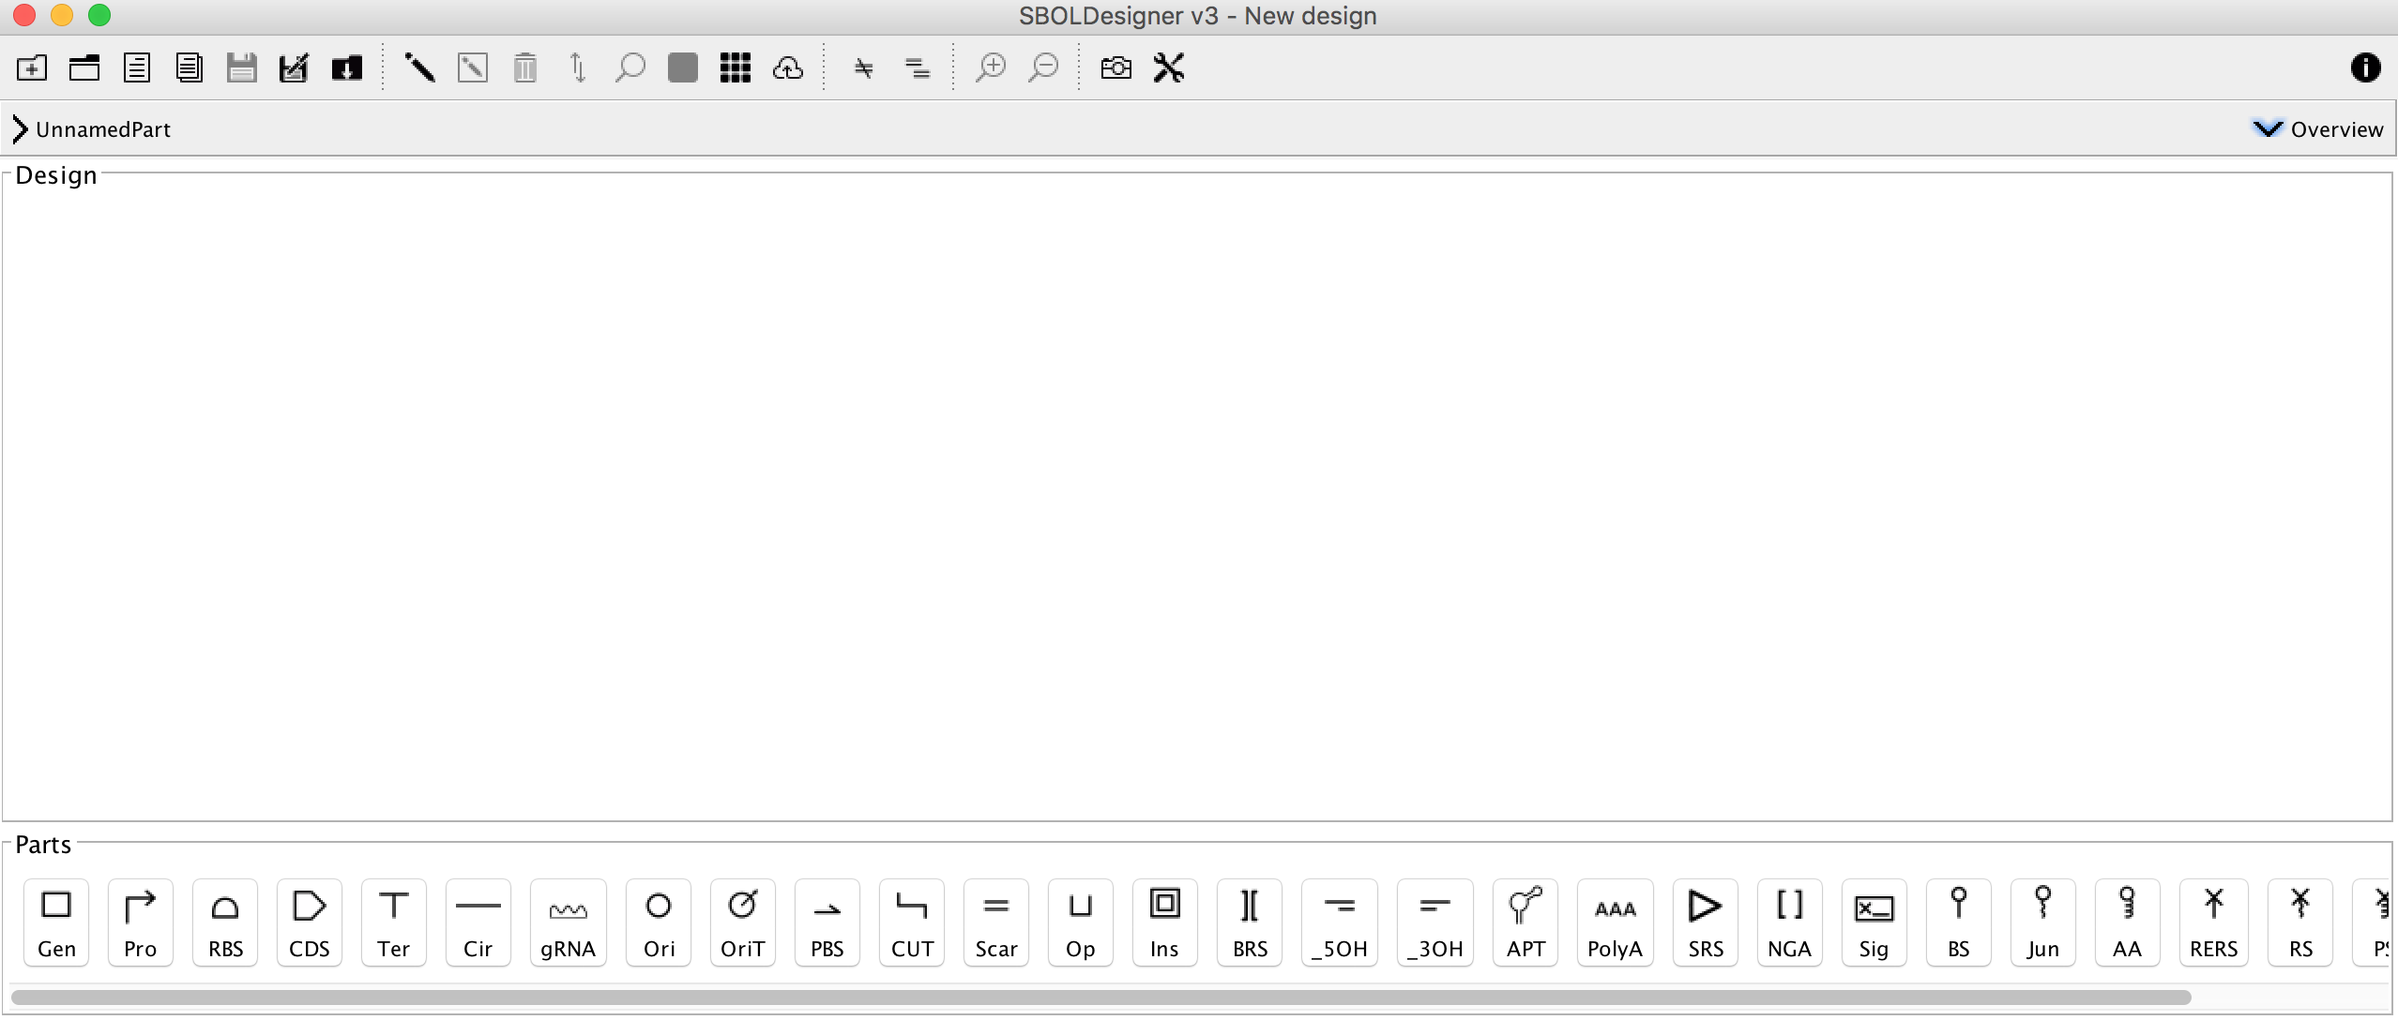
Entry Screen
ToolBar
Design Navigator
Design Canvas
Parts Explorer

Slide 25
Adding Parts to a Design
ToolBar
Design Navigator
Design Canvas
Parts Explorer
ACTIONS
Select the Promoter icon from the Parts Explorer
The Part is added to the Design Canvas
Add a Promoter, a Gen (engineered region) and a Terminator

Slide 26
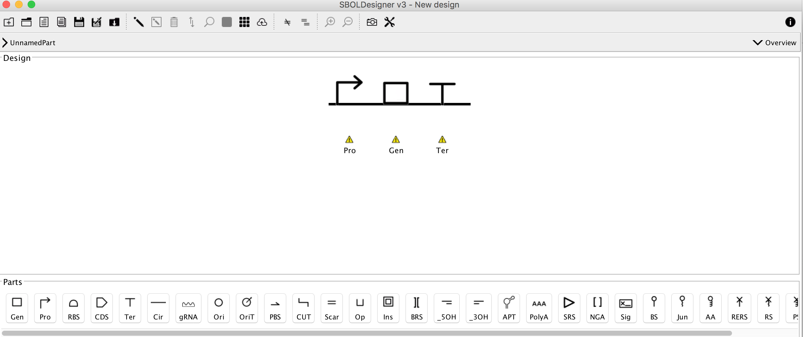
Focus In
Now we want to sketch out the Genetically Engineered Region element.
Fun Fact – also could be called a Module or a Device or a Composite Part
ACTION
Select the Focus In icon
This will Focus the Canvas view on the Genetically Engineered Region Element

Slide 27
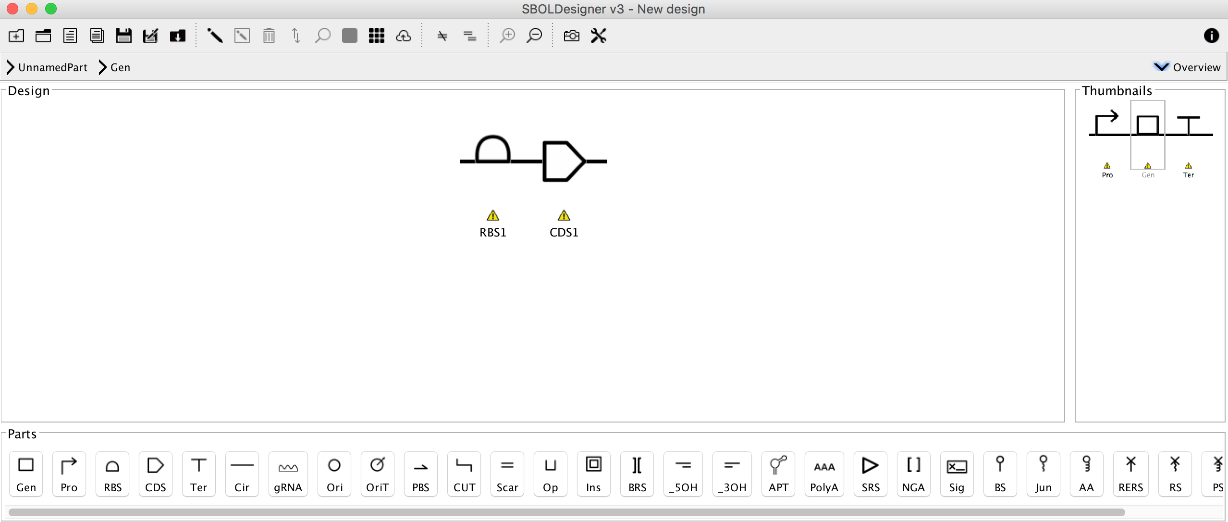
ACTIONS
Select the RBS icon to add it to the canvas
Select the CDS icon to add this Part type
Click the indicated Overview element
This shows the initial level of the design
Double click the RBS Part and we will begin to populate this with our planned Part

Slide 28
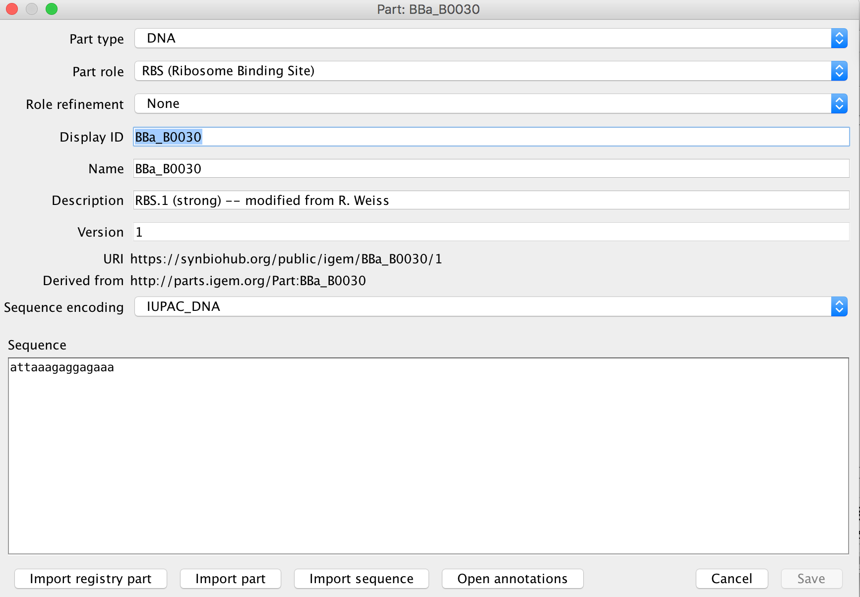
You now see the Import dialog box
ACTION
Select the Import Part button
Navigate to your folder and select
BBa_B0030
Information from the part will autopopulate in the dialog boxes
Select Save
Your Design Canvas will now show BBa_B0030

Slide 29
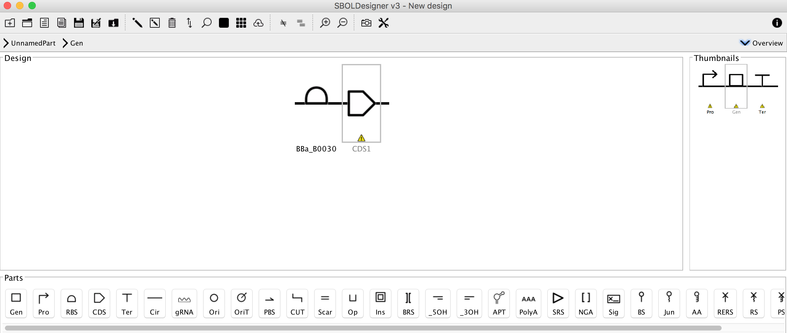
ACTION
Double click to select the CDS Part

Slide 30
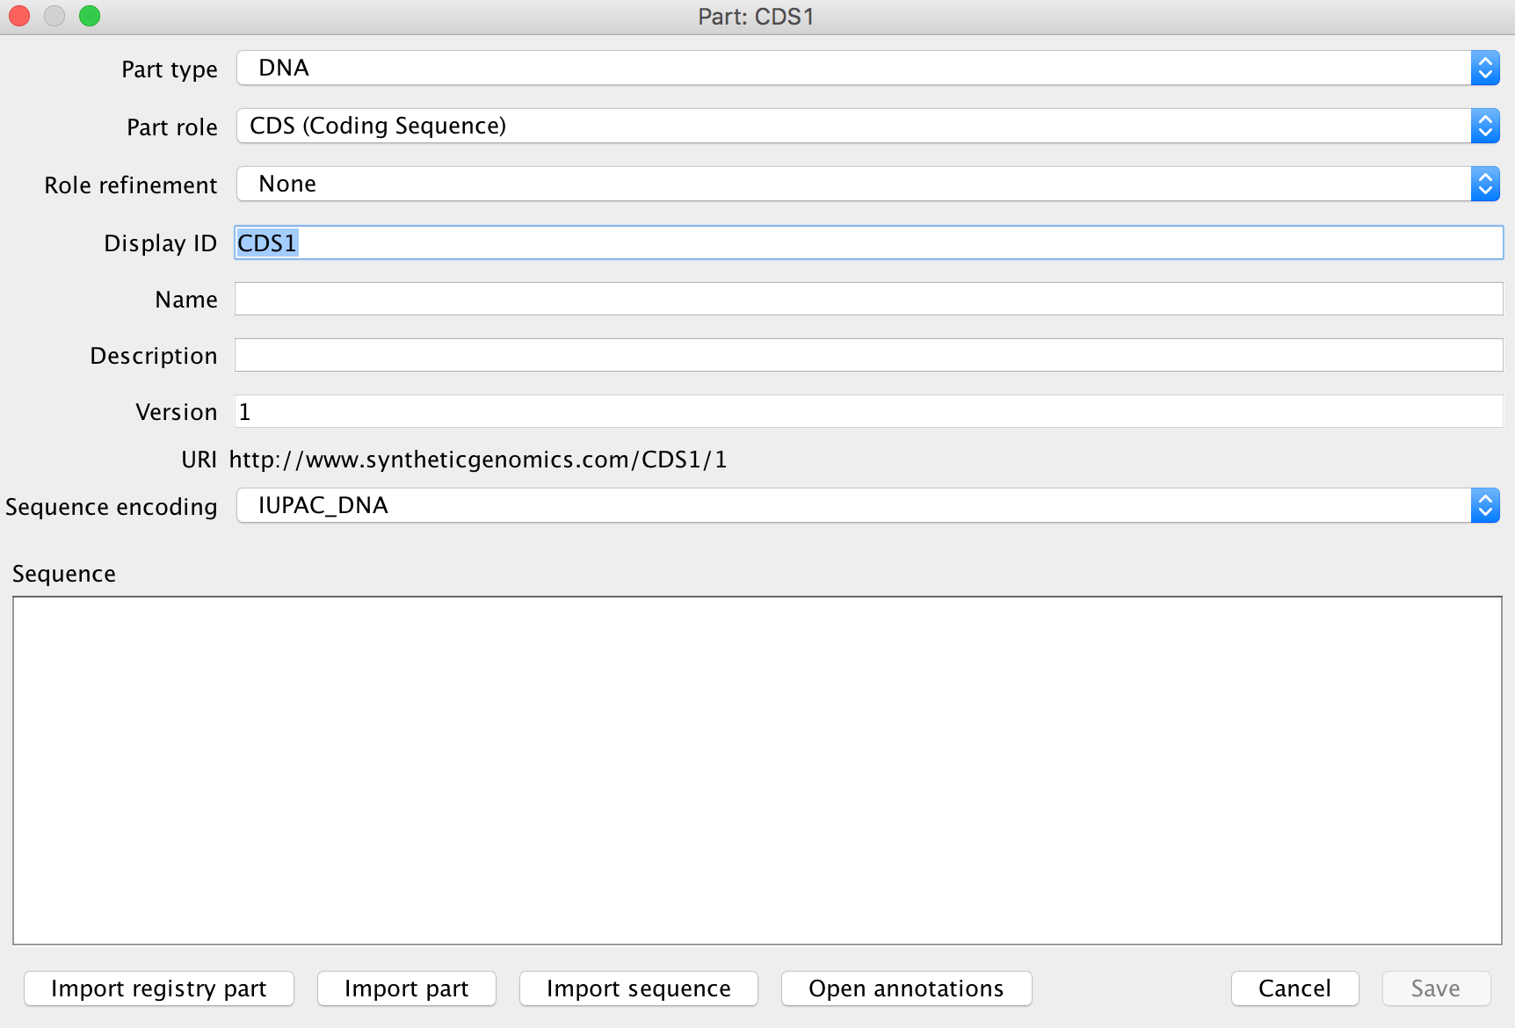
This time we will browse for a part from the
SynBioHub registry
ACTION
Select the Import Registry part button

Slide 31
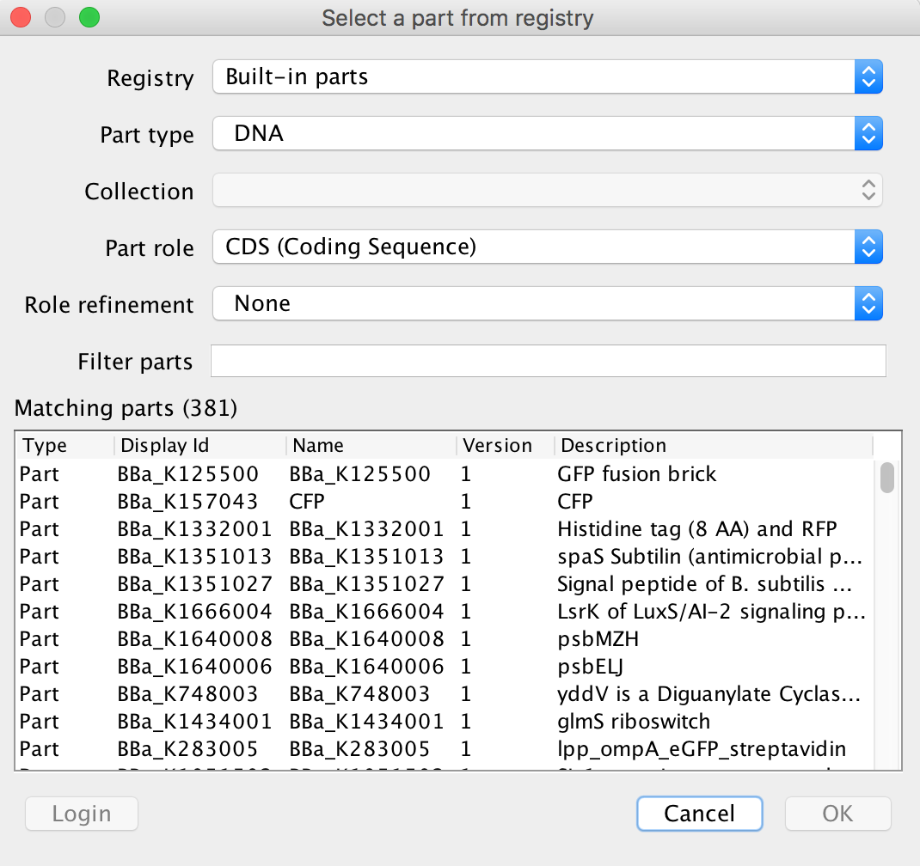
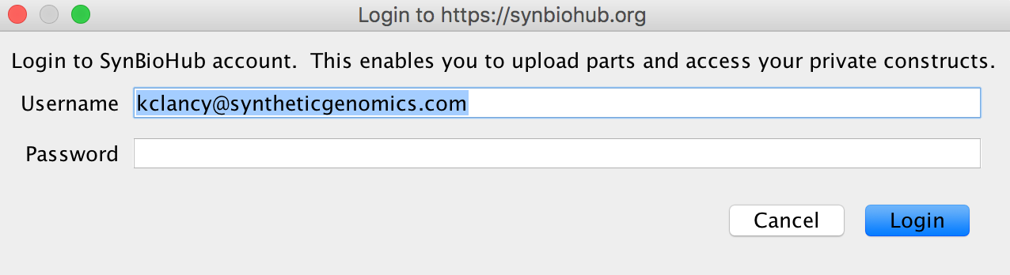
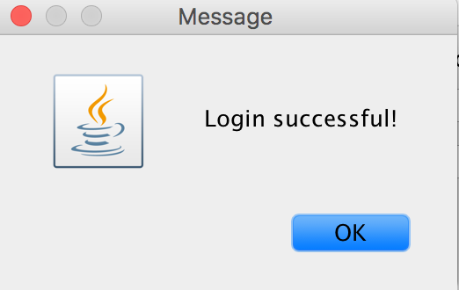
You now see the registry login dialog box
ACTION
Either use your account information, OR
Use our standard account:
Email: sbol.seed.2018@gmail.com
Password: seed2018
Select Login
You now see the registry import dialog box
ACTION
Change Registry to SynBioHub
Select the Login button

Slide 32
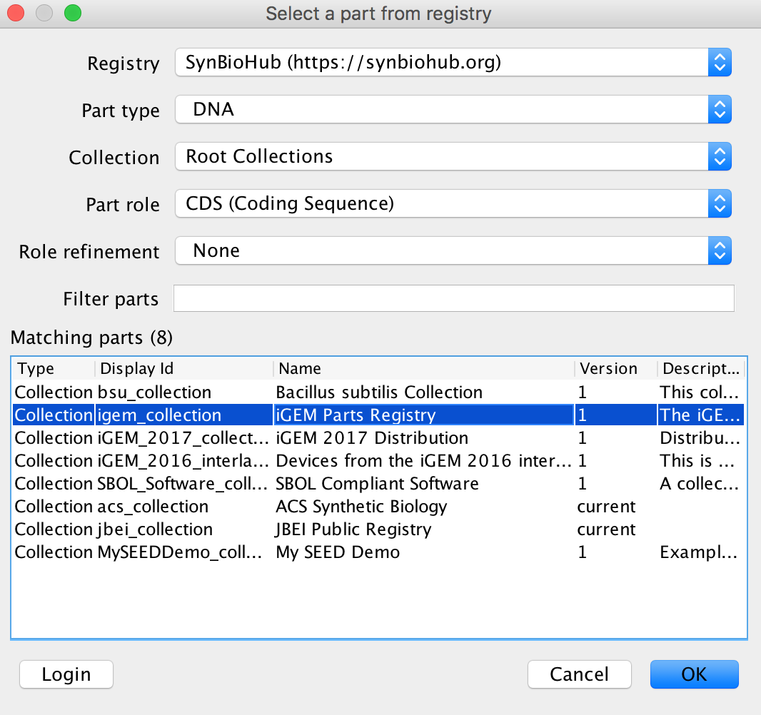
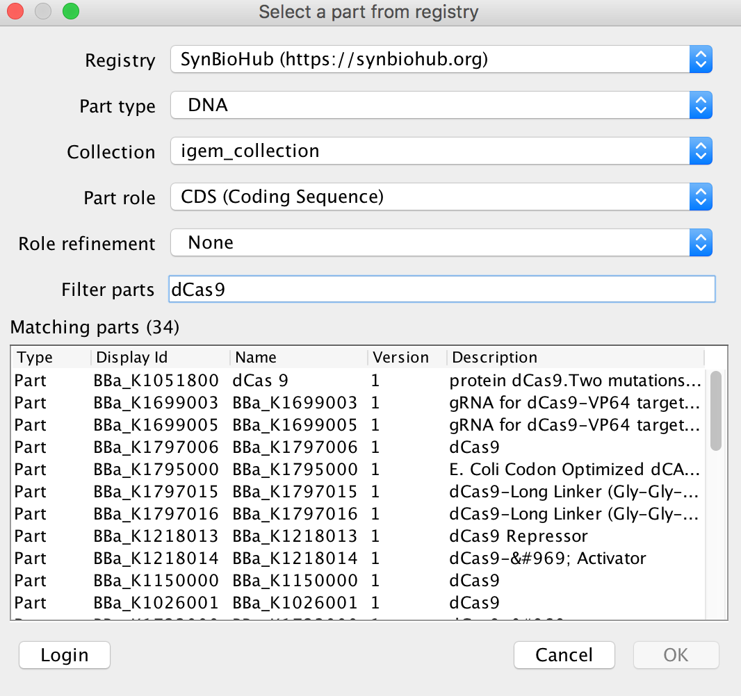
You now see a list of all the CDS parts in the collection
ACTION
Under the Filter parts dialog type dCas9
The collection filters to Parts containing dCas9 in the name or description
Select BBa_K1051800 and hit OK
You now see the registry import dialog box
This now shows available collections
ACTION
Select igem_collection
Double click to load this collection
It takes a few moments to load the names and descriptions of CDS parts from the iGEM collection

Slide 33
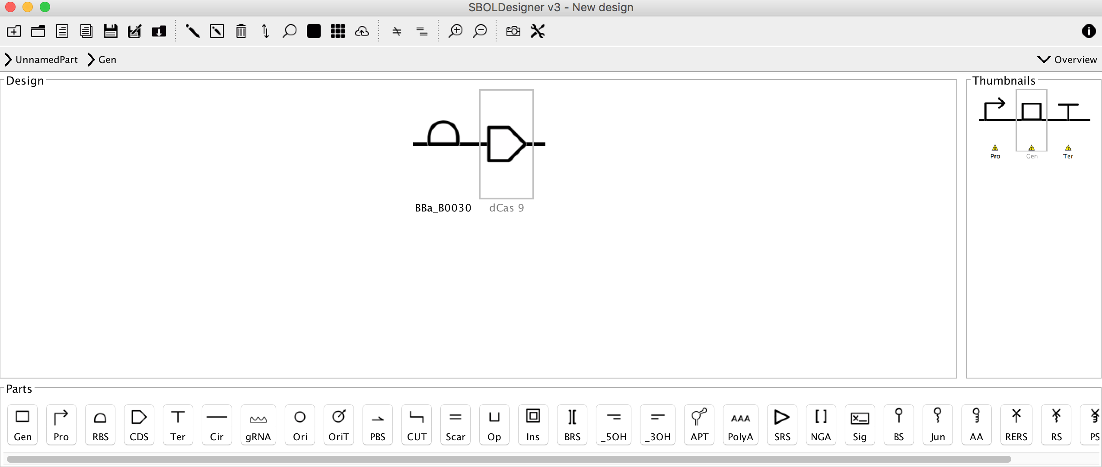
You now see you have populated these two Parts
ACTION
Select the Focus Out icon
We now return to the main Design Canvas

Slide 34
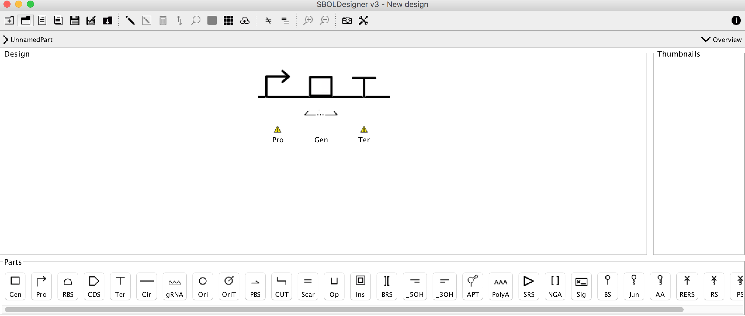
You now see the Gen element has changed – this indicates that it has been populated with Parts
Because we are now back in the main view we no longer see a thumbnail view
ACTION
Double Click on the Gen element
This brings up the Part:Gen dialog box

Slide 35
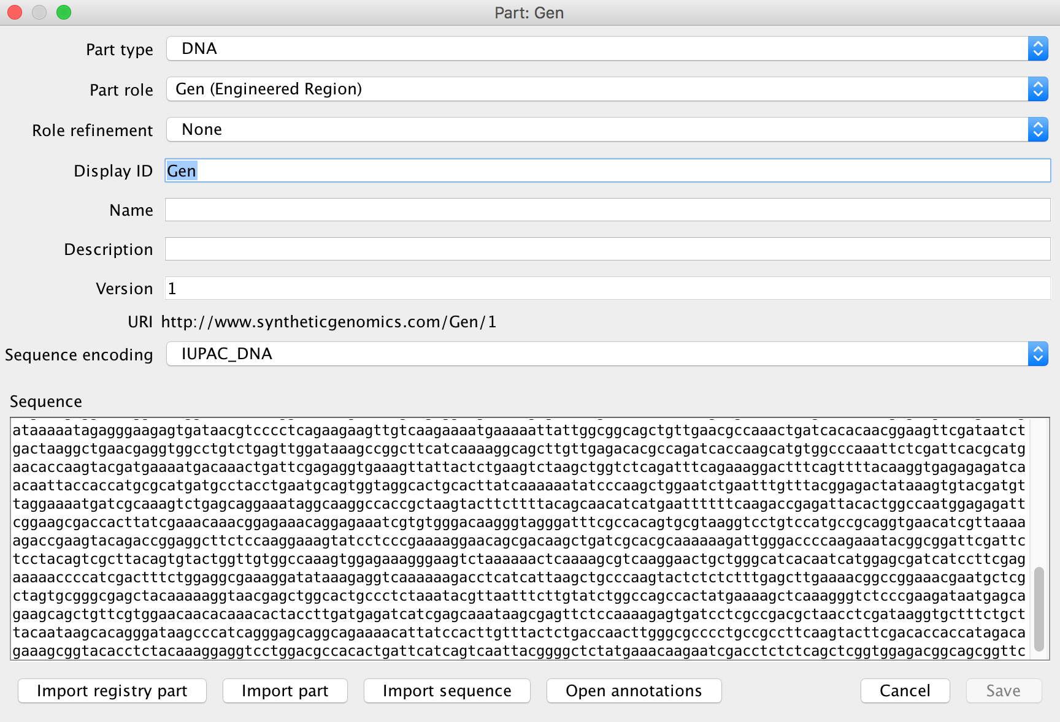
Now we will name the Engineered Region
ACTION
Change the DisplayID to dCas9_Gen
Under description add: “BBa_B0030 and dCas9”
Select Save
The Design Canvas will update the name of the Gen Part.
Select the Focus In icon (remember where it is?)
The Overview icon now shows the newly named Engineered Region Part
This is also reflected in the name of the Region under the Design Navigator bar

Slide 36
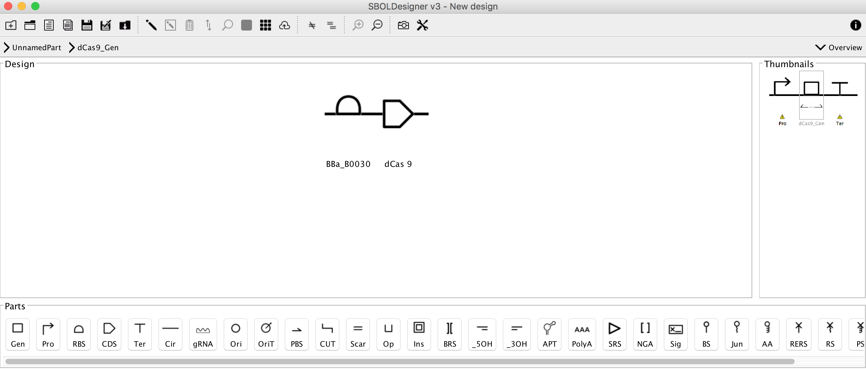
The newly updated Gen part is now showing up in the Design Canvas Overview
and the Design Navigation bar
ACTION
Select the Focus out icon and we’ll populate the Promoter and the Terminators

Slide 37
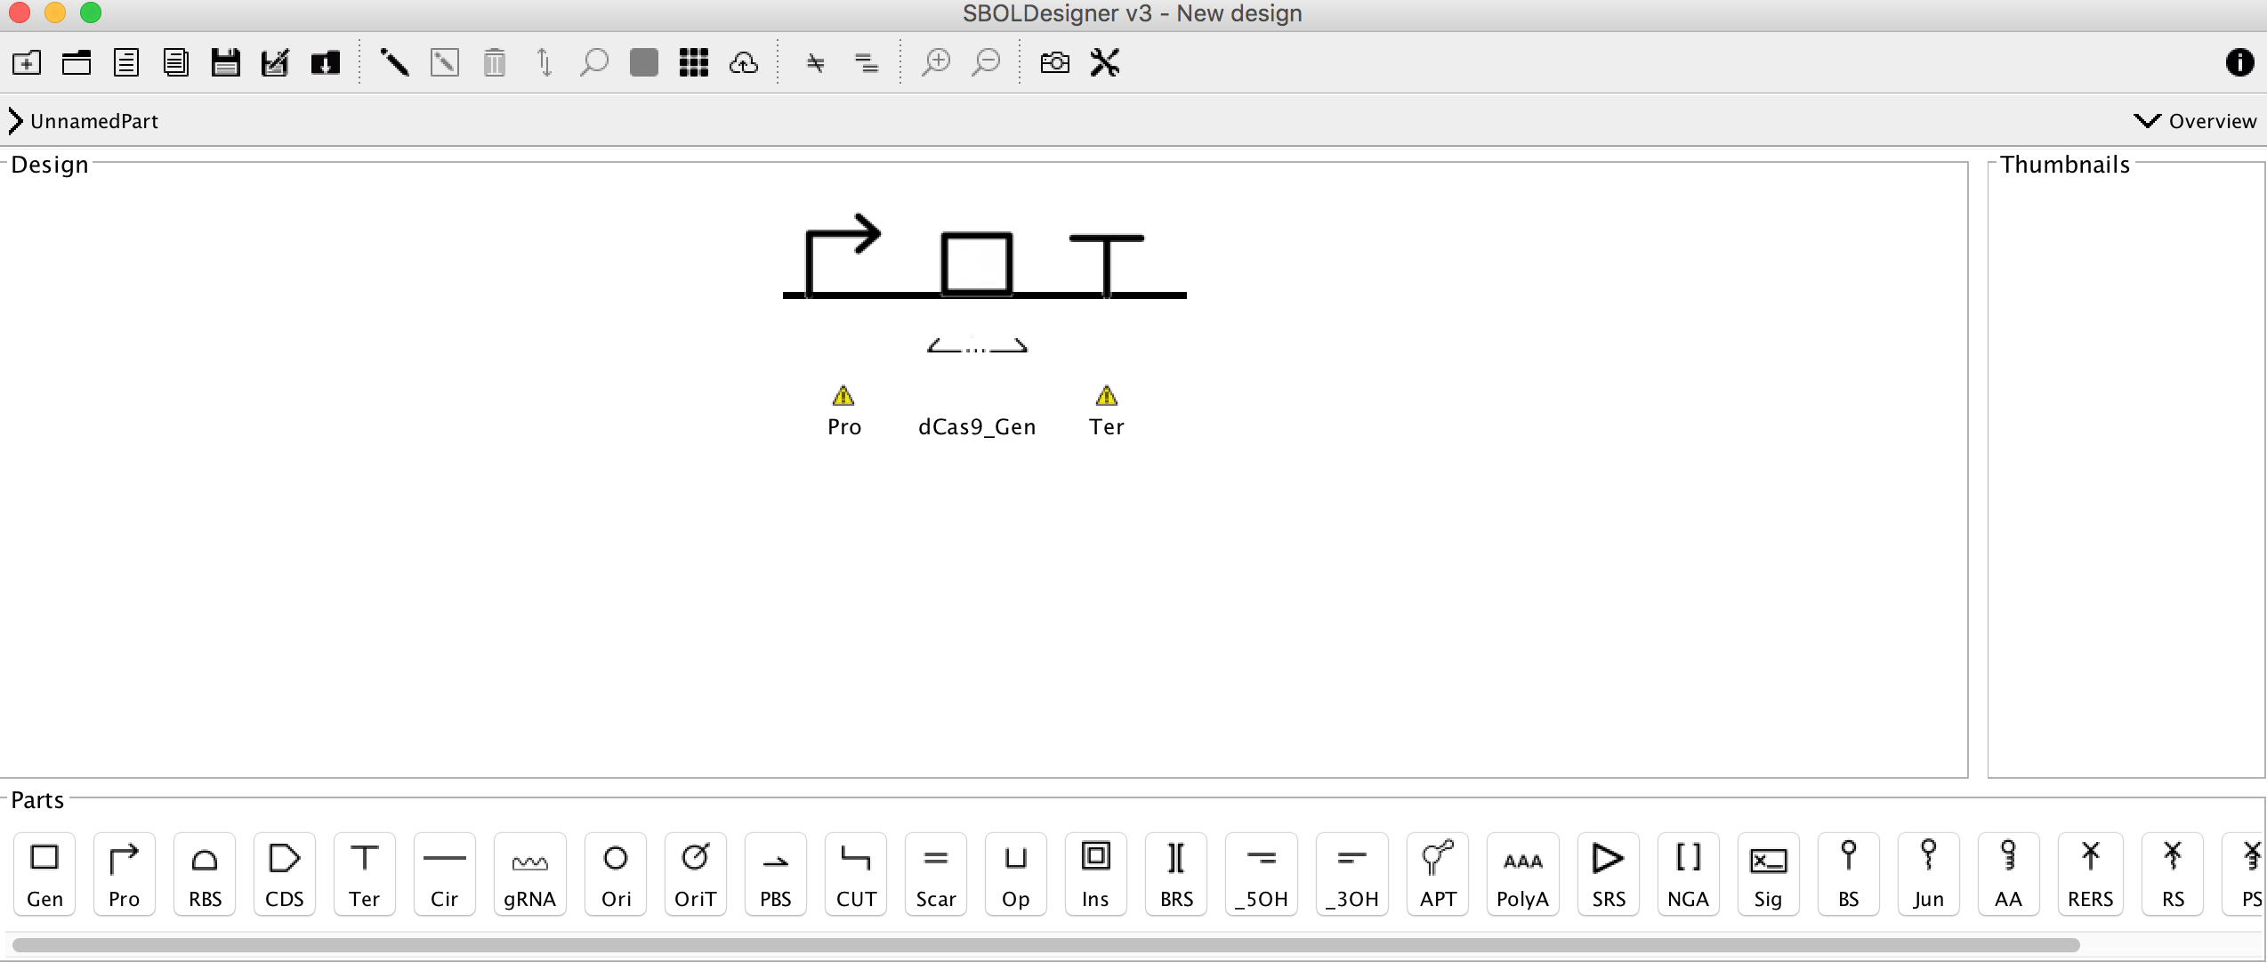
We will add a U6 promoter and a eukaryotic terminator
ACTION
Select the Import from Registry option to search for each of these
Suggestion – filter for a U6 promoter
Suggestion – filter Terminators by the term Eukaryotic

Slide 38
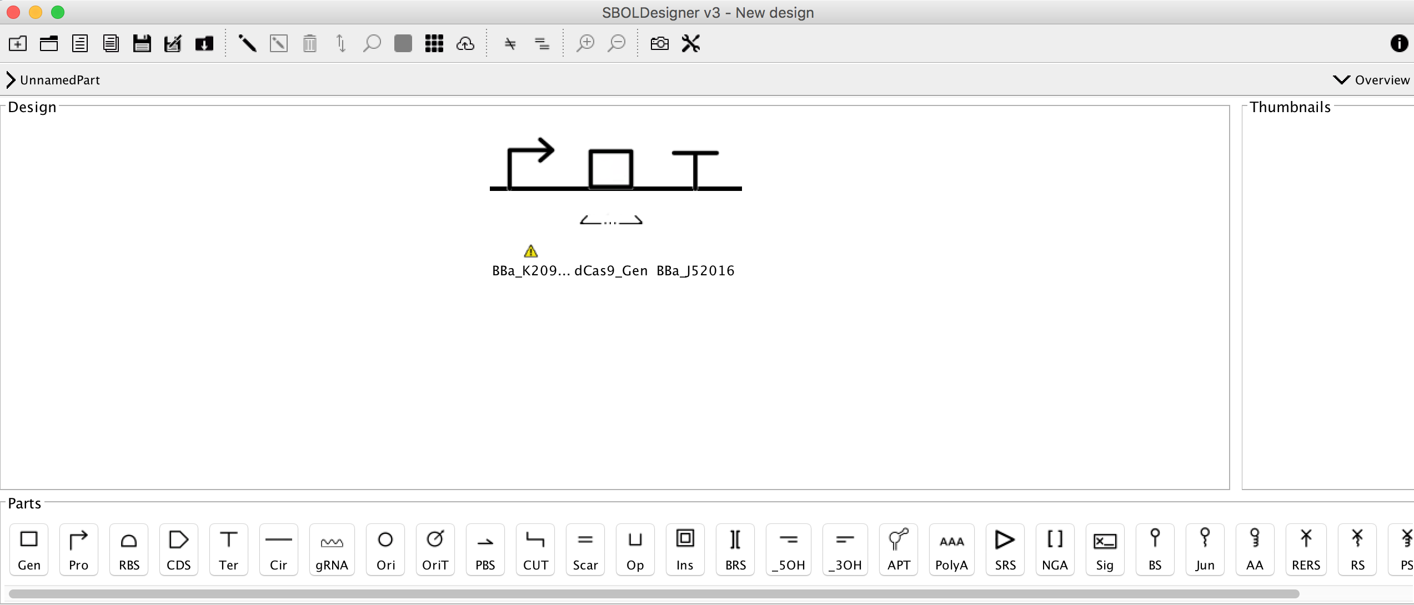
Why does the Promoter part still have an alert besides it?
ACTION
Return to the SynBioHub to discover why
Search on the ID BBa_K2095001

Slide 39
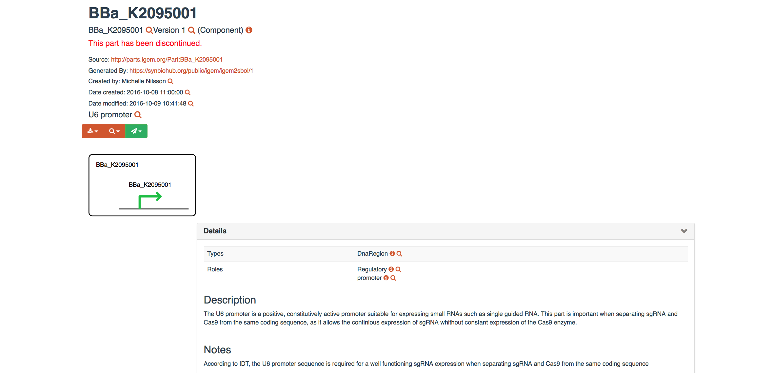
The mystery is solved – the part is discontinued
ACTION
Return to SBOLDesigner and select another U6 promoter part

Slide 40
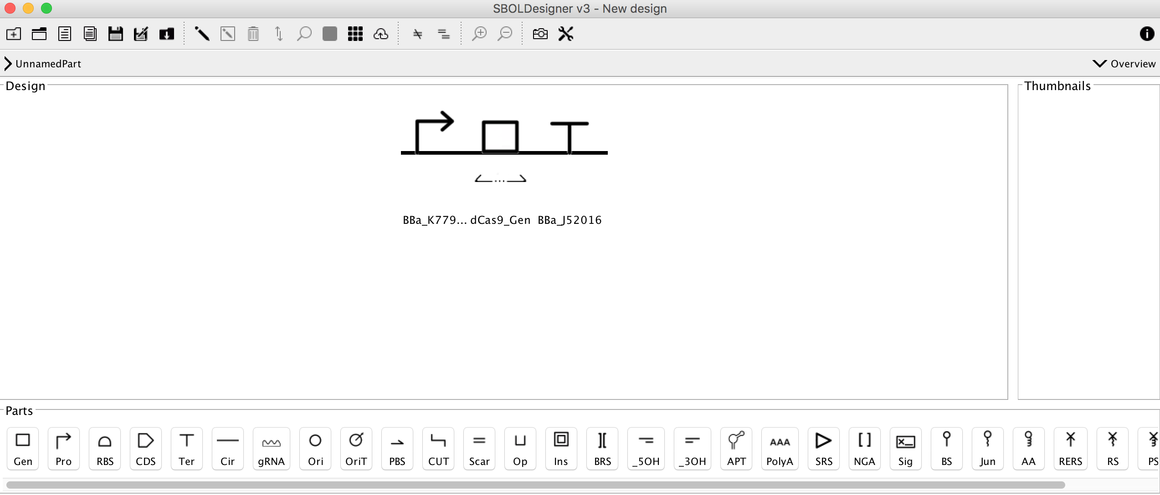
Now I have added another U6 promoter and the design shows no warnings
ACTION
Select the Save Current design As a New Document icon to save the session
Give the design the name pU6-dCas9 device
Save it to your examples folder

Slide 41
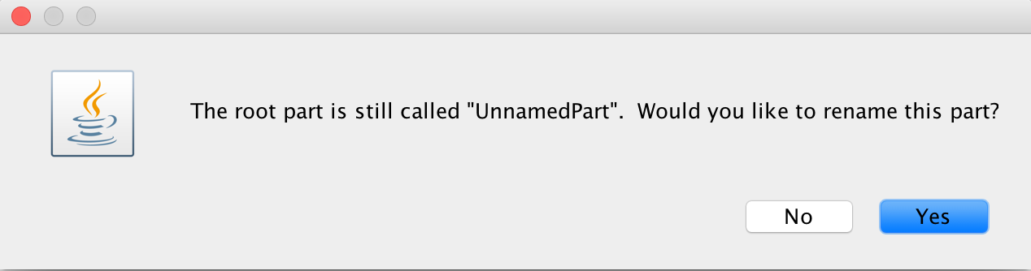
ACTION
Do choose to rename the part
I used PartID pU6_dCas9
Save it to a new Folder – Example 2 SBOLDesigner

Slide 42
Now want to upload my design to SynBioHub
ACTION
Select the Current Design for Upload to SynBioHub
Make sure you select SynBioHub as the repository to upload to
Select Existing Collection if you want to use the Collection you made earlier, otherwise set up a new one
The software will find an recommend your Collection folder
Your upload should finish with an indicator of success!

Slide 43
Example 2 Summary
We:
Installed SBOLDesigner
Started a Design Project
Connected with SynBioHub to download parts
Poplated our design
Saved it
Uploaded it to SynBioHub

Slide 44
Example 3 – using the SBOL Converter
We will:
Convert a GenBank file to SBOL format
Convert an SBOL File to GenBank format

Slide 45
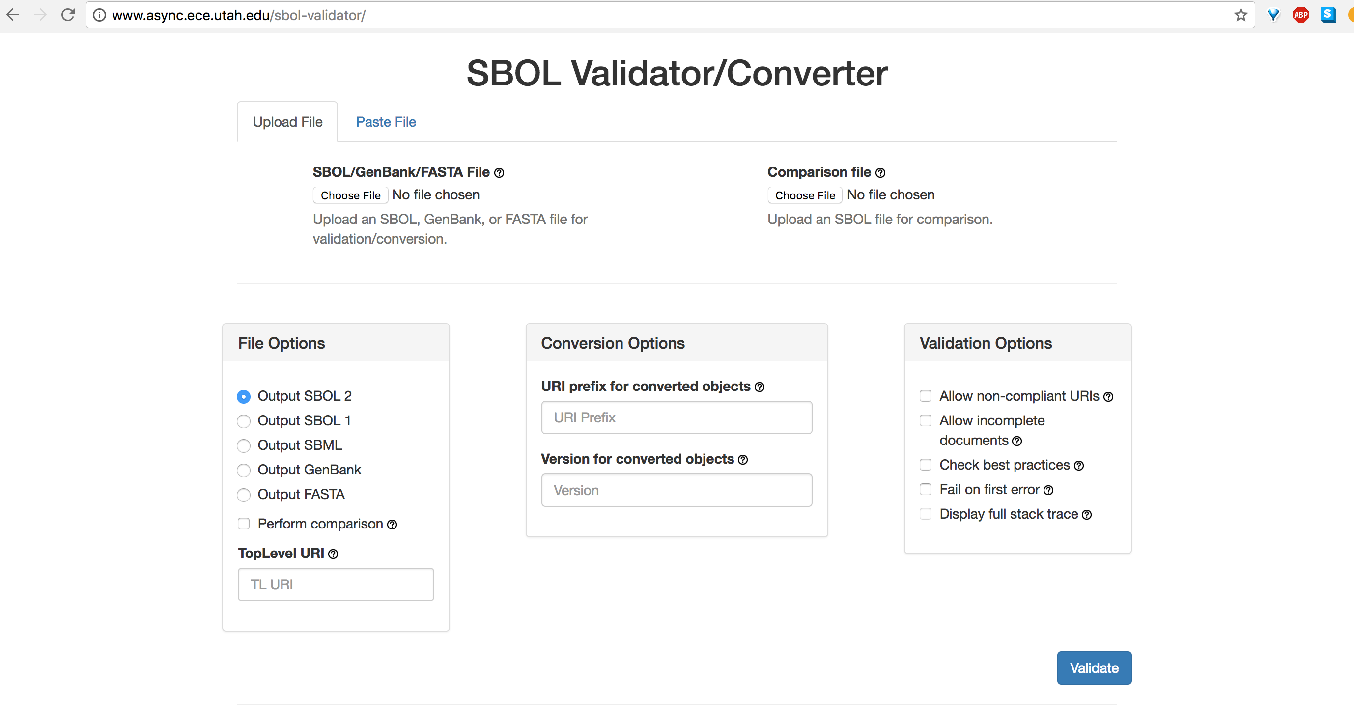
This tool allows you to interconvert between different File Formats and SBOL
Developers: Nathan Hilson, Berkeley Lab; Chris Myers lab, U. Utah
It has 2 purposes:
Converting files between formats
Confirming the file you generated meets SBOL compliance (used mainly by developers)
ACTION
In the GitHub repository please open Example 3
We will use the SYNCAS9.gbk file as an example

Slide 46
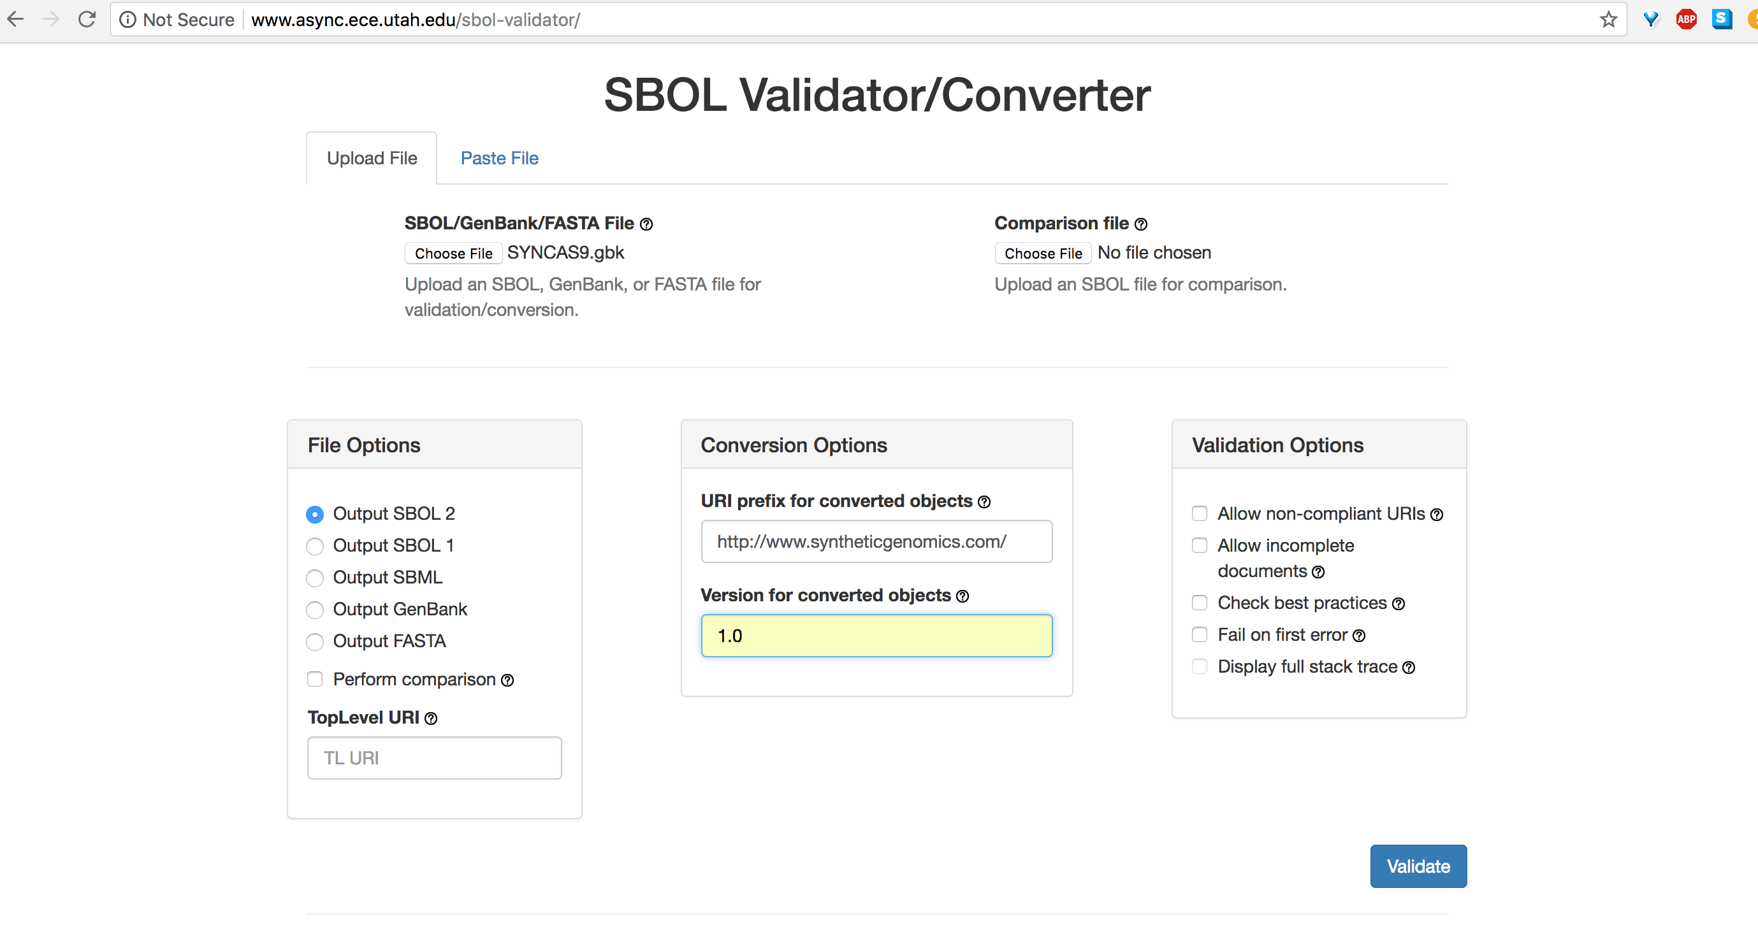
ACTION
Upload SYNCAS9.gbk using the Choose File button
Add a URI such as your institutional URL – eg www.syntheticgenomics.com
Add a Version to the file – eg 1.0
Select Validate
Upload your file to SBOLDesigner to inspect it
Hint – use the Load an Existing SBOL Document icon on the Toolbar
Second from the Left…
BONUS POINTS
Run your SBOL file back through the converter to GenBank or Fasta format
Try converting the other files in the Example 3 set
Use your design from Example 2

Slide 47
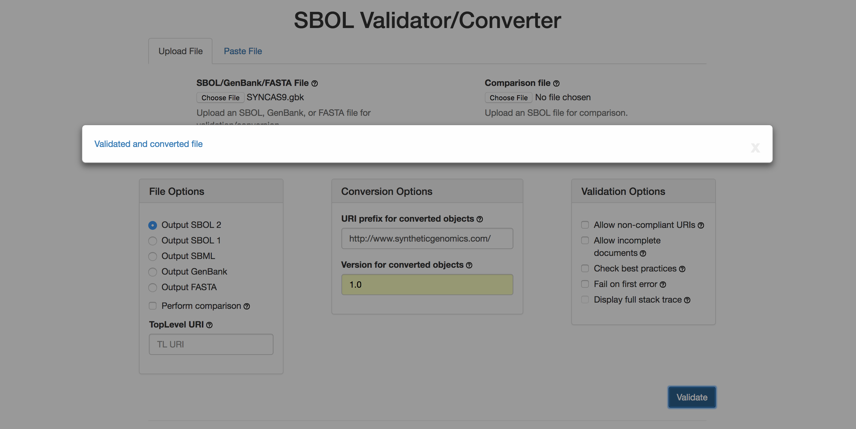
Most common cause of problems:
Your file does not have a true NCBI header line
This is sadly common among the output files from many web sites
Solutions
Compare your header to a file downloaded from NCBI and adjust it
Download it from NCBI
Odd NCBI like headers will be fixed in future releases of the Validator/Converter

Slide 48
Example 3 Summary
We:
Converted a GenBank file to SBOL format
Visualized it in SBOLDesigner
Optional – converted an SBOL file into GenBank format

Slide 49
Example 4 - BOOST
We will:
Use the Workflow Manager to set up a Gene Synthesis request
Upload a GenBank file
Set up parameters for codon juggling and synthesis
Set up parameters for partitioning of sequence blocks
Specify an output
Inspect the output
Build-OptimizatiOn Software Tools (BOOST) is a platform of tools to design DNA sequences for manufacturing.
Currently, BOOST consists of three tools:
(i) The "Juggler" reverse translates protein sequences into DNA sequences and
codon juggles DNA sequences,
(ii) The "Polisher" verifies DNA sequences against DNA synthesis constraints. The "Polisher"
can modify the protein coding regions of DNA sequences in order to resolve eventual violations of DNA synthesis constraints.
(iii) The "Partitioner" decomposes large DNA sequences into synthesizable building blocks with assembly-specific overlap
sequences. Contact Person: Ernst Oberortner Organization(s): DOE Joint Genome Institute, Lawrence Berkeley National Labs

Slide 50
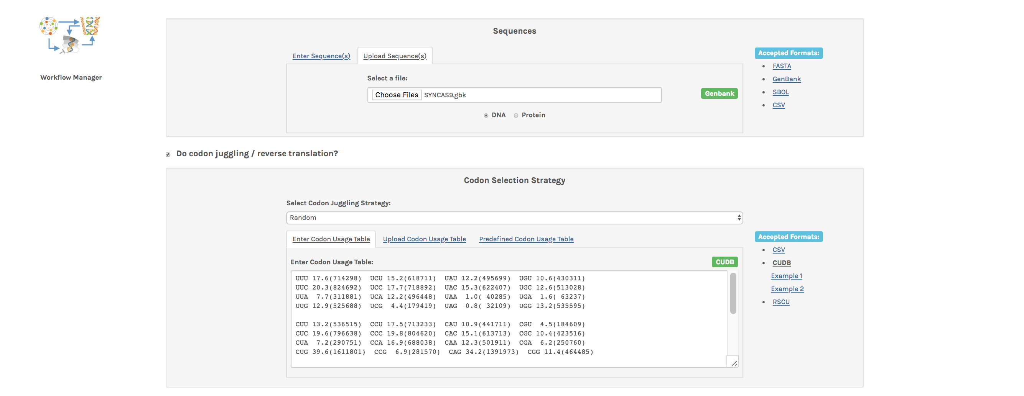
ACTIONS
Log into BOOST via this URL: https://boost.jgi.doe.gov
You need to set up a new account
Select the SYNCAS9.gbk file from Example 4 to upload to the web site
Select the HomoSapiens codon usage table for Codon juggling

Slide 51
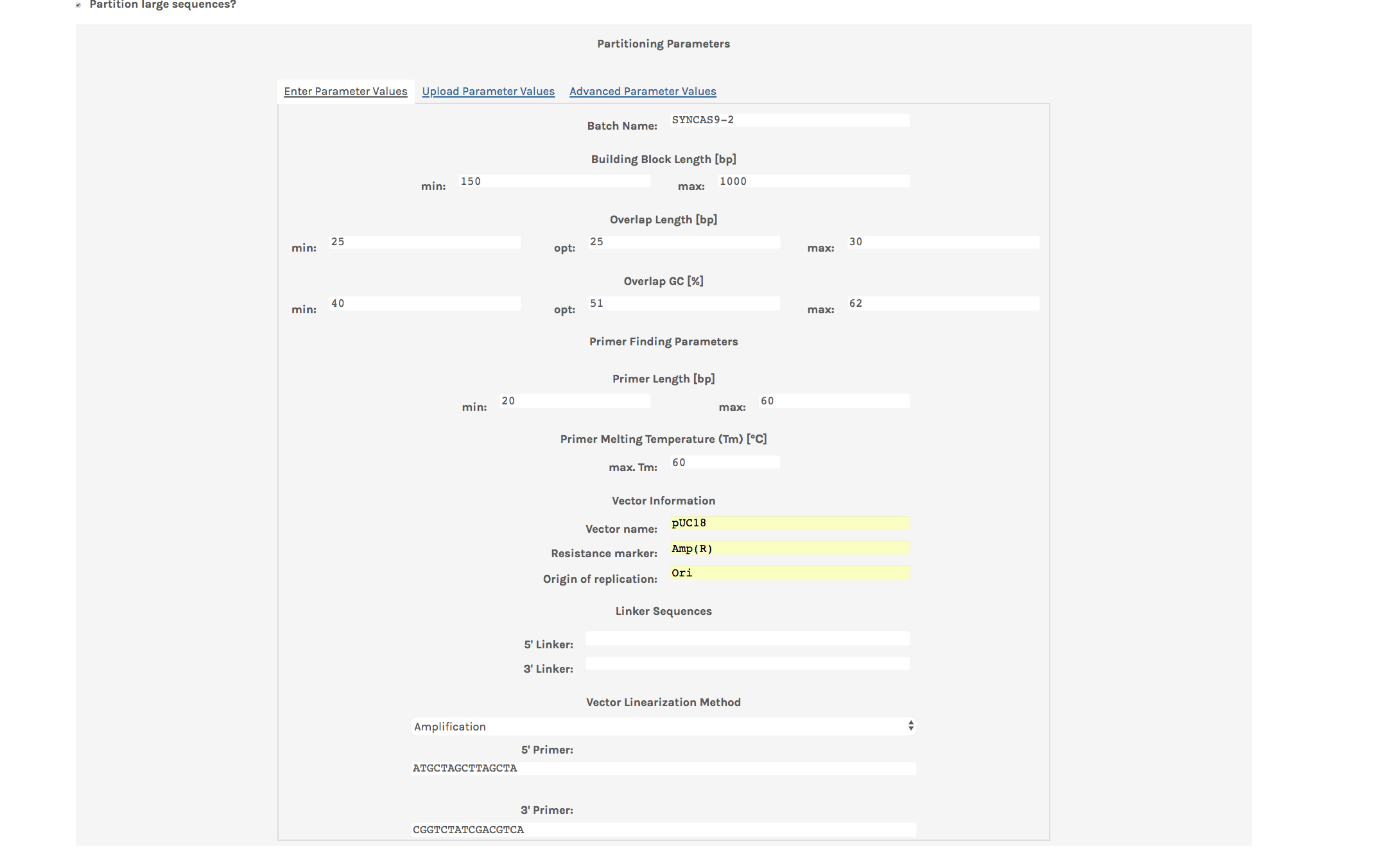
ACTIONS
Give your file a Batch name, eg SYNCAS9-1
Adjust Block length to 1000
Use a maximal primer length of 60
Populate the Vector fields with information
Select Vector amplification and add appropriate primer sequences

Slide 52
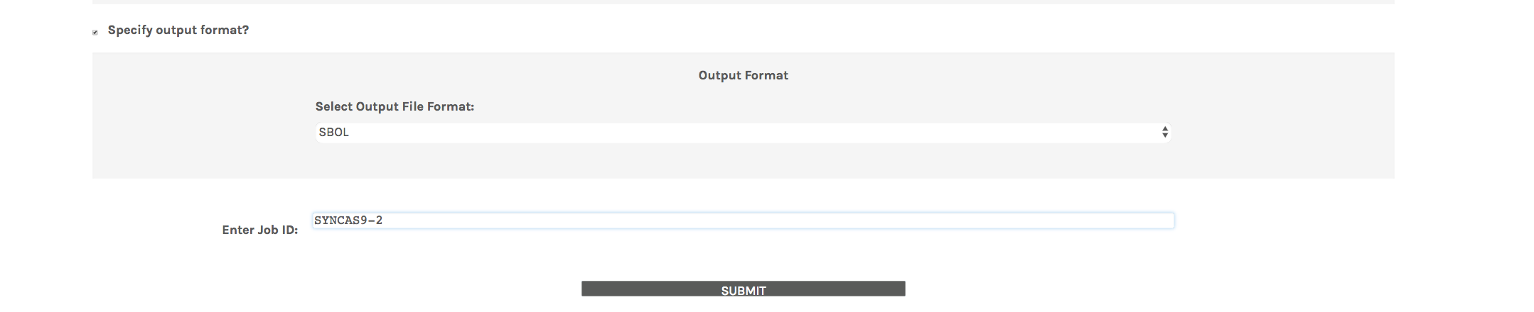
ACTION
Select SBOL as an output format
Enter a job id
Submit!

Slide 53
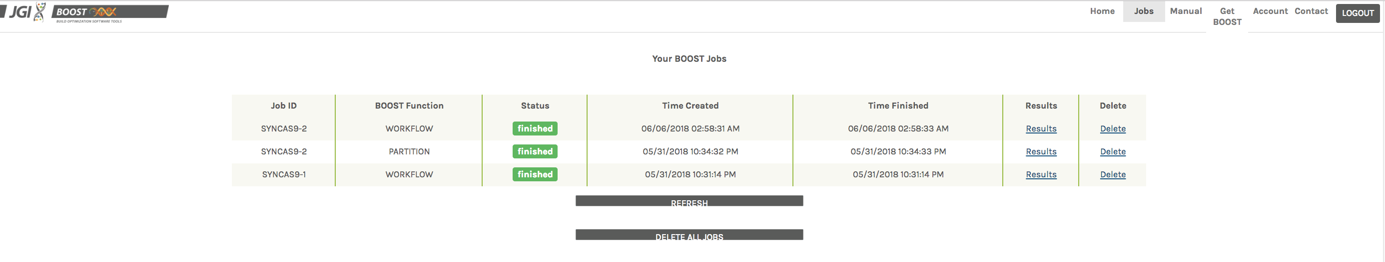
The dash board will show the status of your requests.
ACTION
Select Results to retrieve the result file

Slide 54
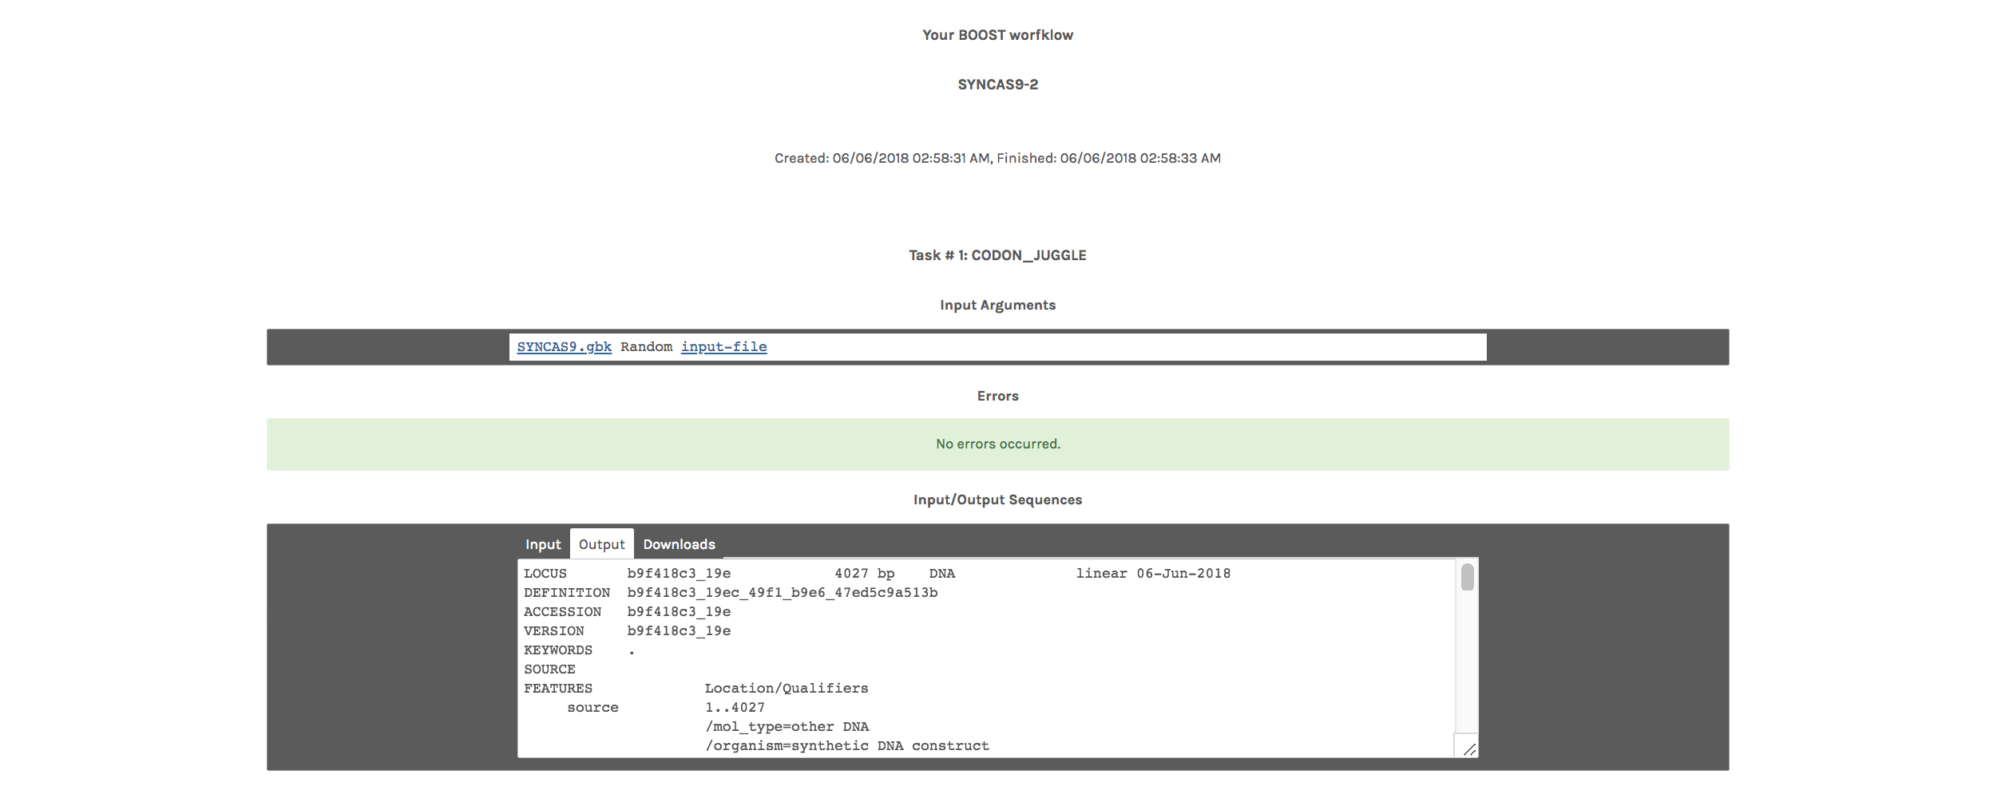

Slide 55
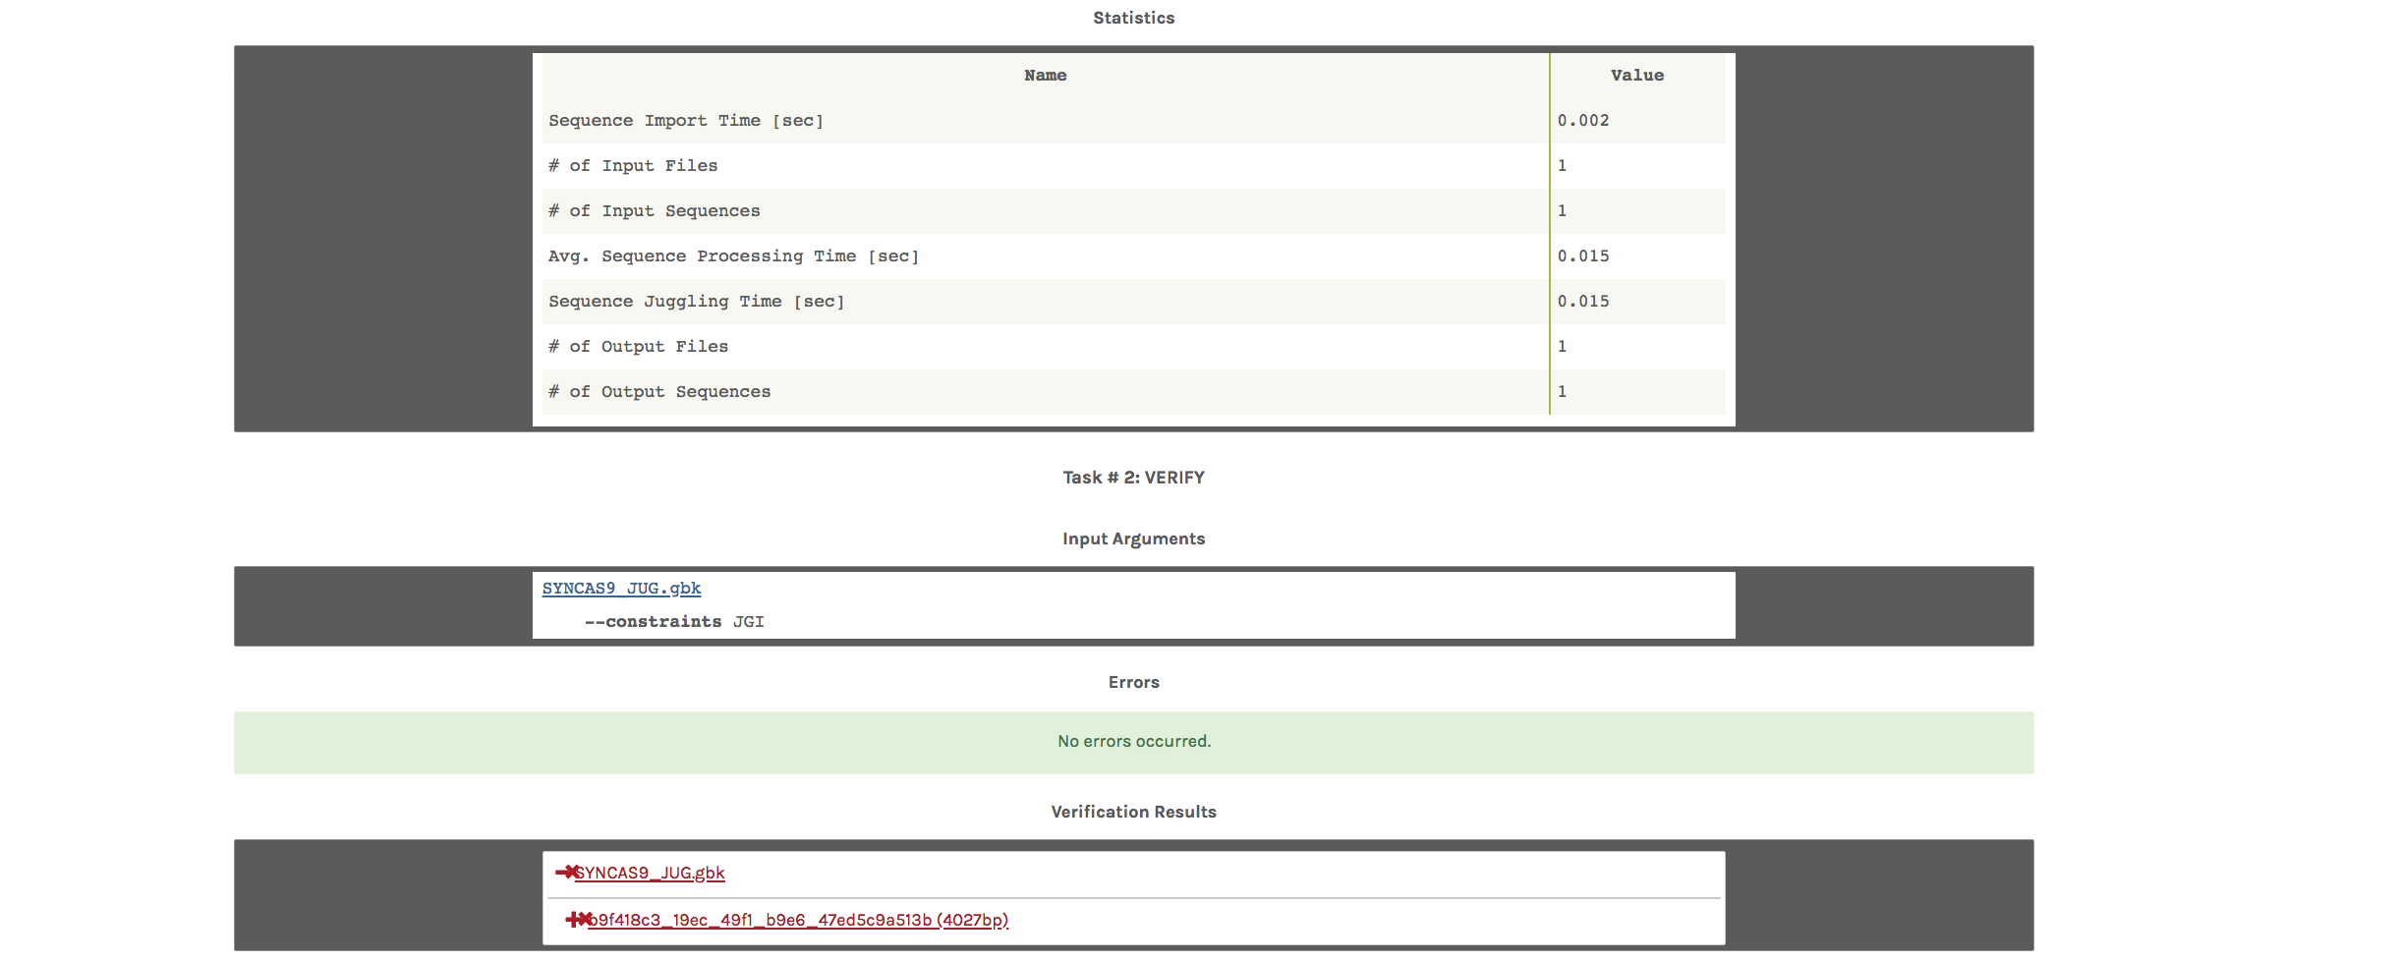

Slide 56
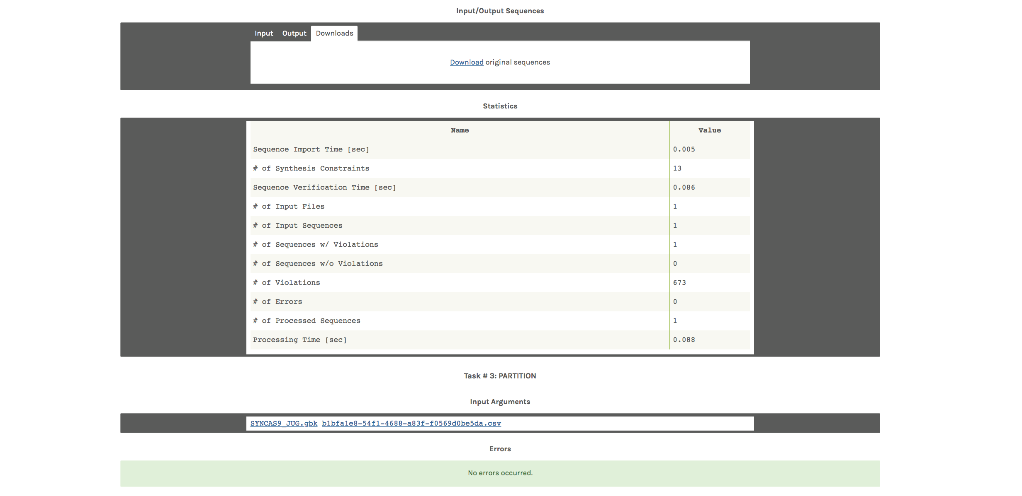

Slide 57
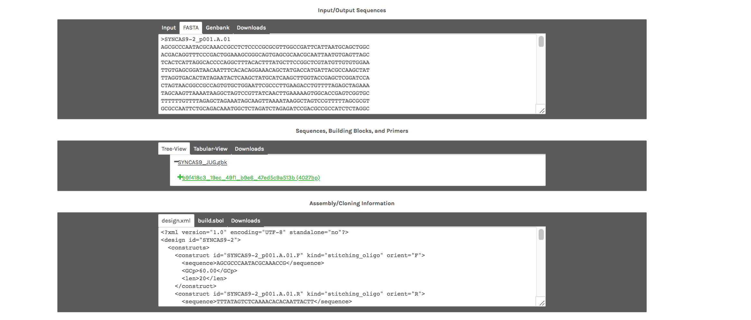

Slide 58
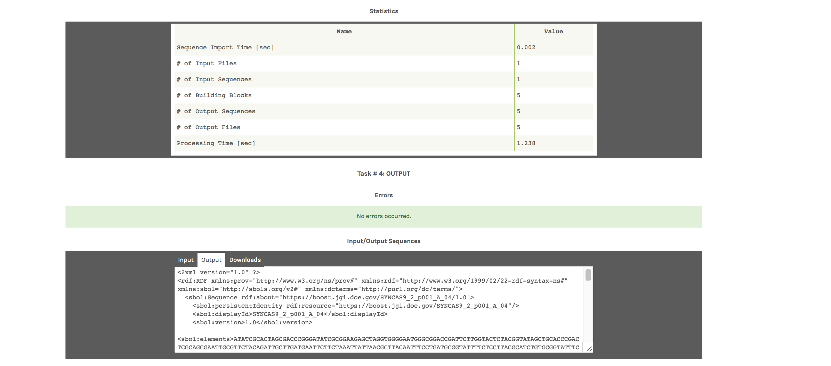
ACTIONS:
Select Downloads
Output both the Original and Juggled files in SBOL format
Open them in SBOLDesigner

Slide 59
Example 4 Summary
We:
Used the Workflow Manager to set up a Gene Synthesis request
Uploaded a GenBank file
Set up parameters for codon juggling and synthesis
Set up parameters for partitioning of sequence blocks
Specified an output
Inspected the output

Slide 60
Example 5 – Gene Genie
We will:
Use GeneGenie to design oligos for an in-house synthesis reaction
Select a protein sequence and add it to the web page
Adjust parameters for oligo designs
Run and analysis
Inspect some of the output files

Slide 61
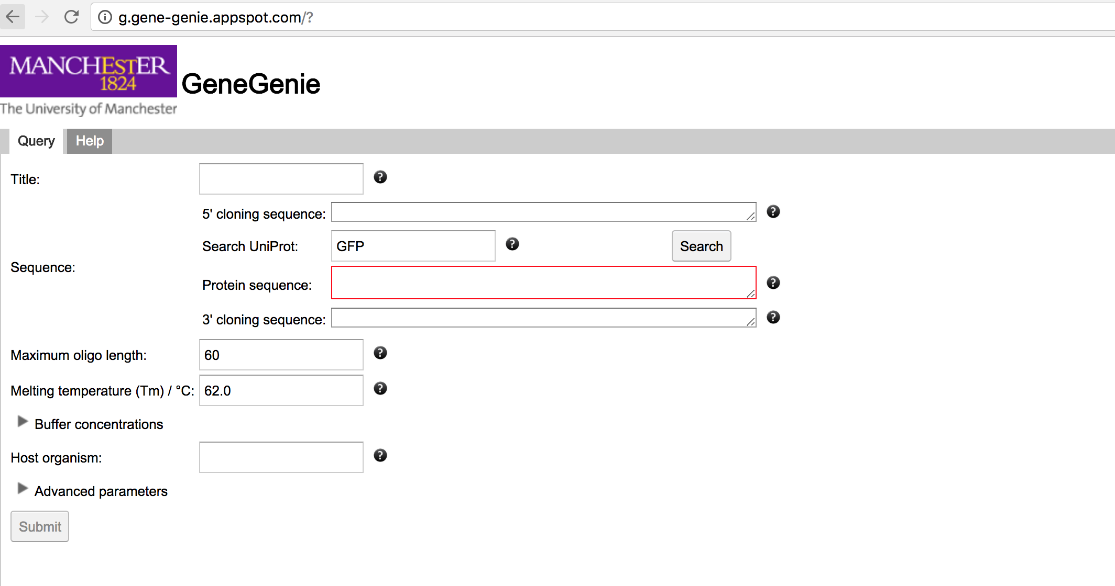
GeneGenie supports the design and self-assembly of synthetic genes and constructs. GeneGenie allows for the design of oligonucleotide cohorts encoding the gene sequence optimized for expression in any suitable host through an intuitive, easy-to-use web interface. The tool ensures consistent oligomer overlapping melting temperatures, minimizes the likelihood of misannealing, optimizes codon usage for expression in a selected host, allows for specification of forward and reverse cloning sequences and also provides support for mutagenesis or directed evolution studies
Contact Person: Neil Swainston Organization(s): Manchester Centre for Synthetic Biology of Fine and Specialty Chemicals (SYNBIOCHEM)

Slide 62
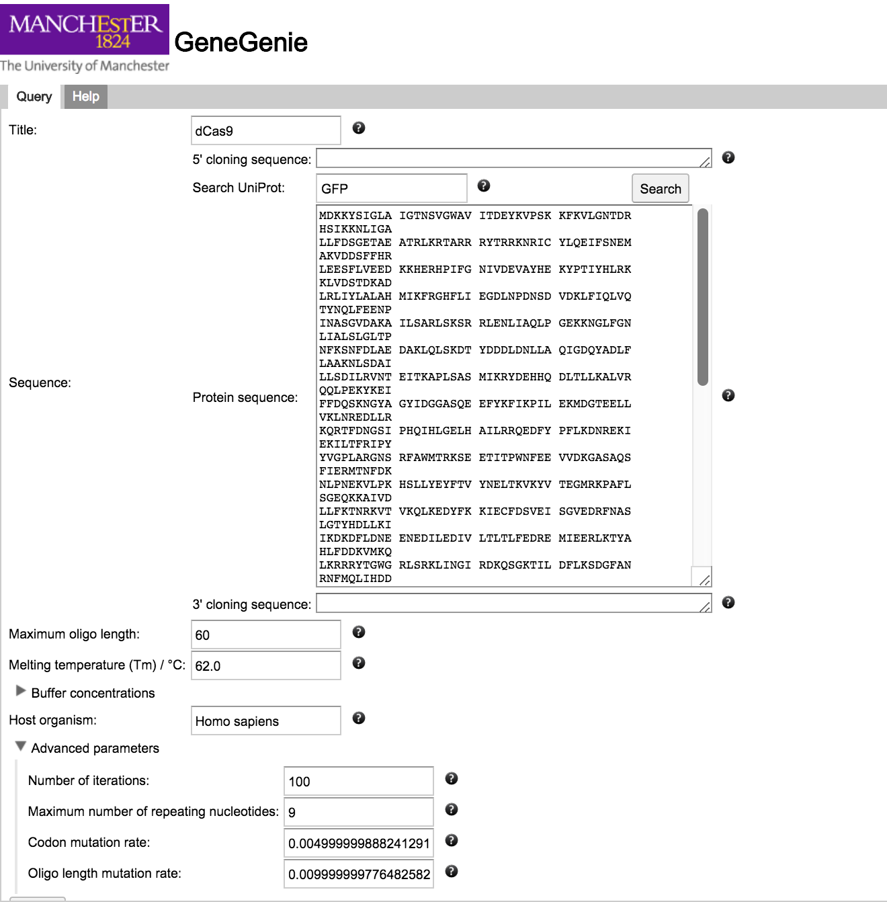
ACTIONS
In the Example 5 – GeneGenie folder open the KR)11748.gbk file with a text editor.
Select the translated dCAS9 protein sequence
Paste it into the Protein Sequence box
Type Homo sapiens as your Host organism
Under advanced parameters select 100 iterations
Change maximum number of repeating nucleotides to 9
Submit

Slide 63

The software has a very nice progress meter indicating the parameters the algorithm is juggling

Slide 64

When competed you can
save the web page
Scroll down to the Oligos table and export this in SBOL format
You can visualize this in SBOL designer
You can add these as sub-elements in an Engineered Region design as well

Slide 65
Example 5 Summary
We:
Selected a protein sequence and added it to the web page
Adjusted parameters for oligo designs
Ran an analysis
Inspected some of the output files

Slide 66
Example 6 - iBioSim

